Slide 1
New parallel architectures for
medical simulation
Hadrien Courtecuisse

Slide 2
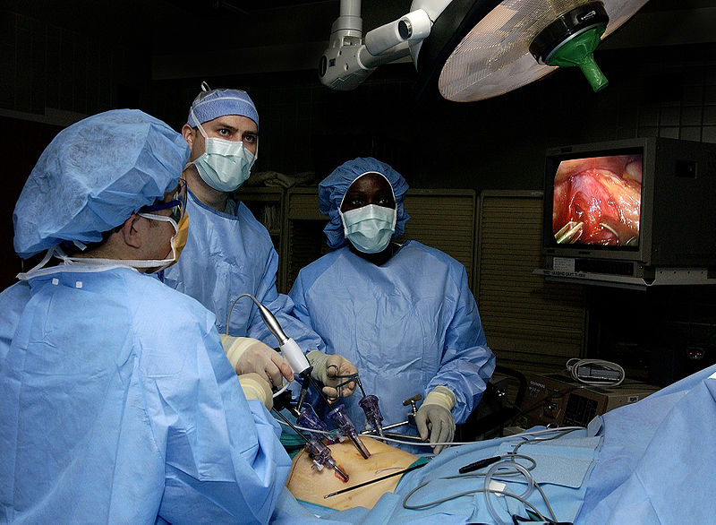
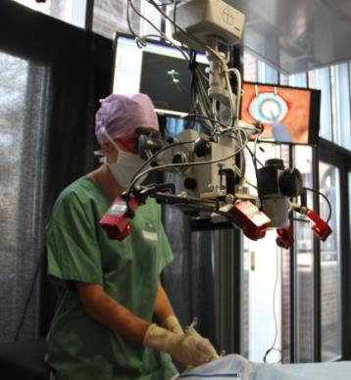
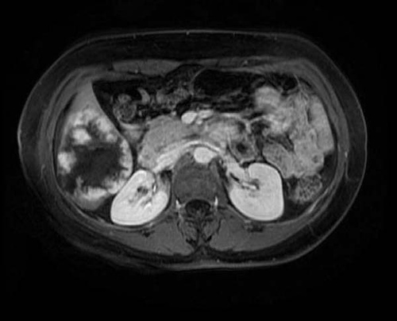
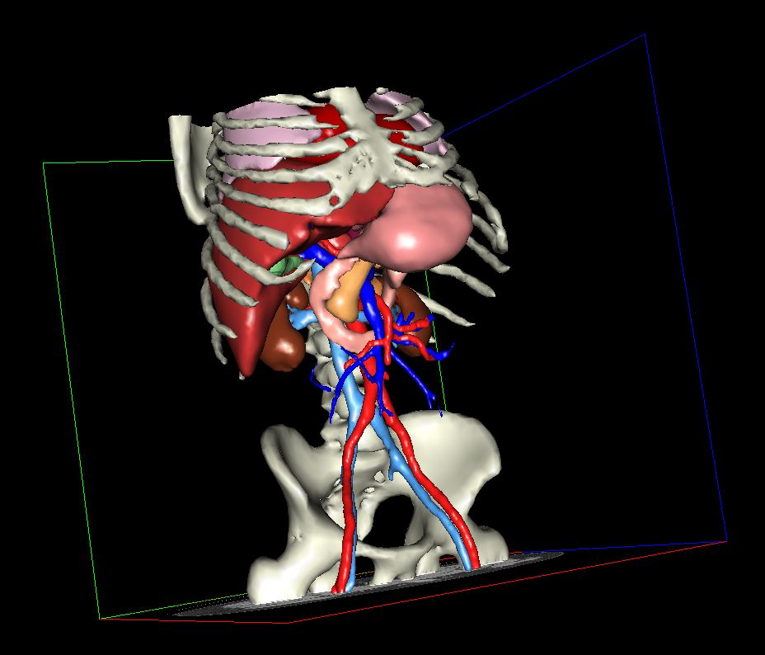
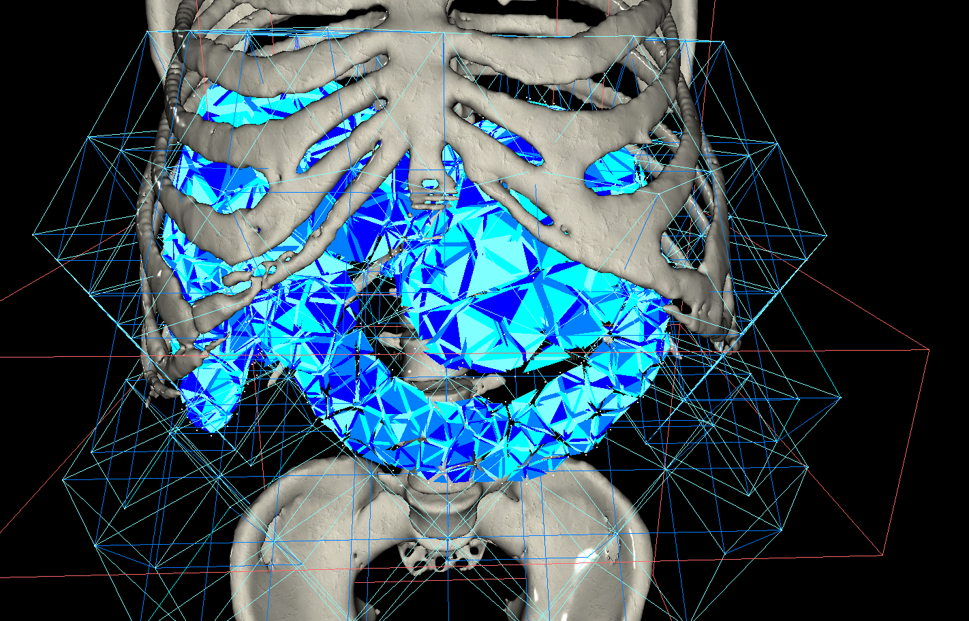
Medical Simulations
Surgery : complex practice
Require a long training
Involve many risks
New technologies :
Mini-invasive surgery, interventional radiology
Interface the surgeon and the patient
Video control, no haptic sensations
Reproduce a similar surgical fields
Create a virtual representation of the patient :
Give a bio-mechanical behavior

Slide 3
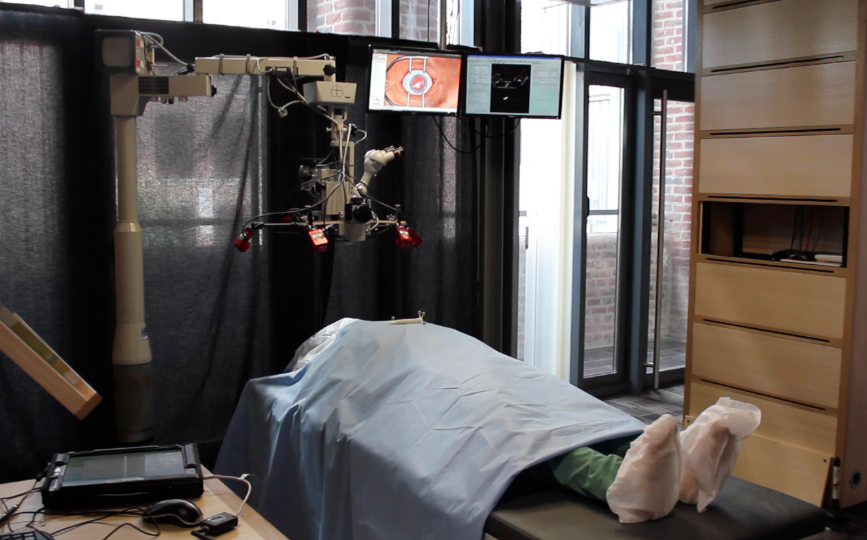
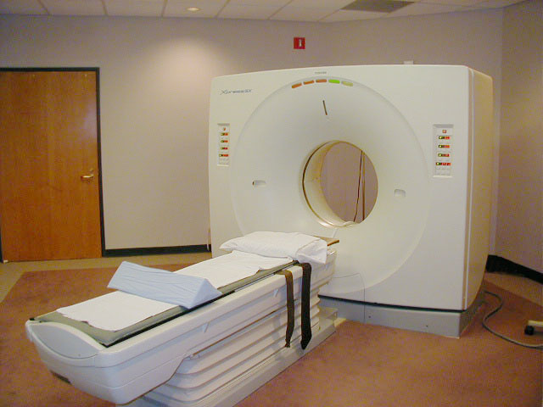
Medical Simulations
Sim
Precision
Learning
Planning
Assistance
Computation time constraints
Simulation for training :
Decrease the learning time
Improve training
Pacification of a complex surgery :
Evaluation of the best strategy
Select the equipment best suited
Simulations patient-specific
Assistance during the operation :
Give more information to surgeons
Decrease risks of the operation

Slide 4
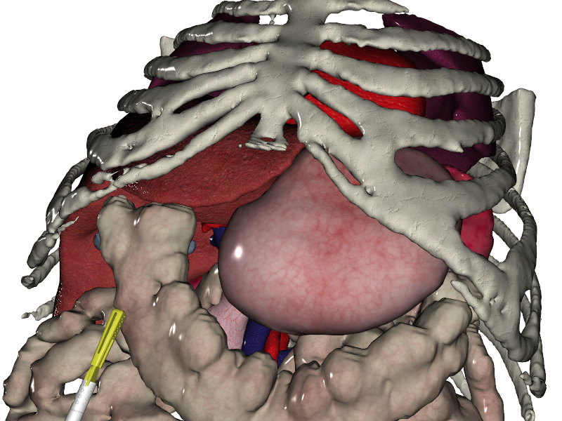
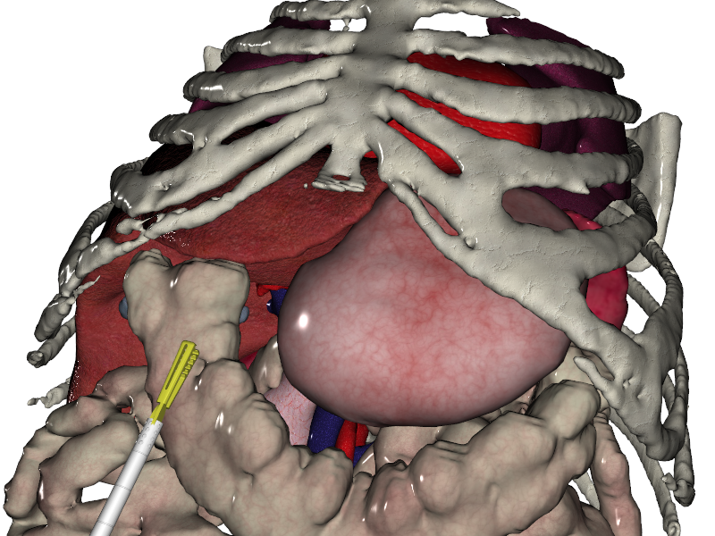
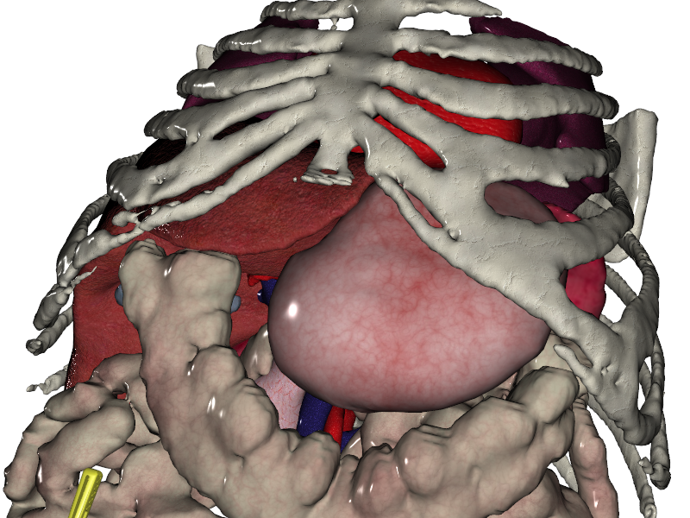
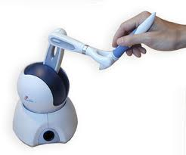
Interactive Simulations
Interactive simulation :
Fast computation
Human interaction
Several steps :
Computation of the deformation
Collision detection
Contact resolution
Rendering of the simulation
All must be done 25 times per second
Deformation
User action
Collision detection
Simulation loop
Human interaction :
Use stable algorithms
Unpredictable motion
Haptic device
Contact resolution
Rendering

Slide 5
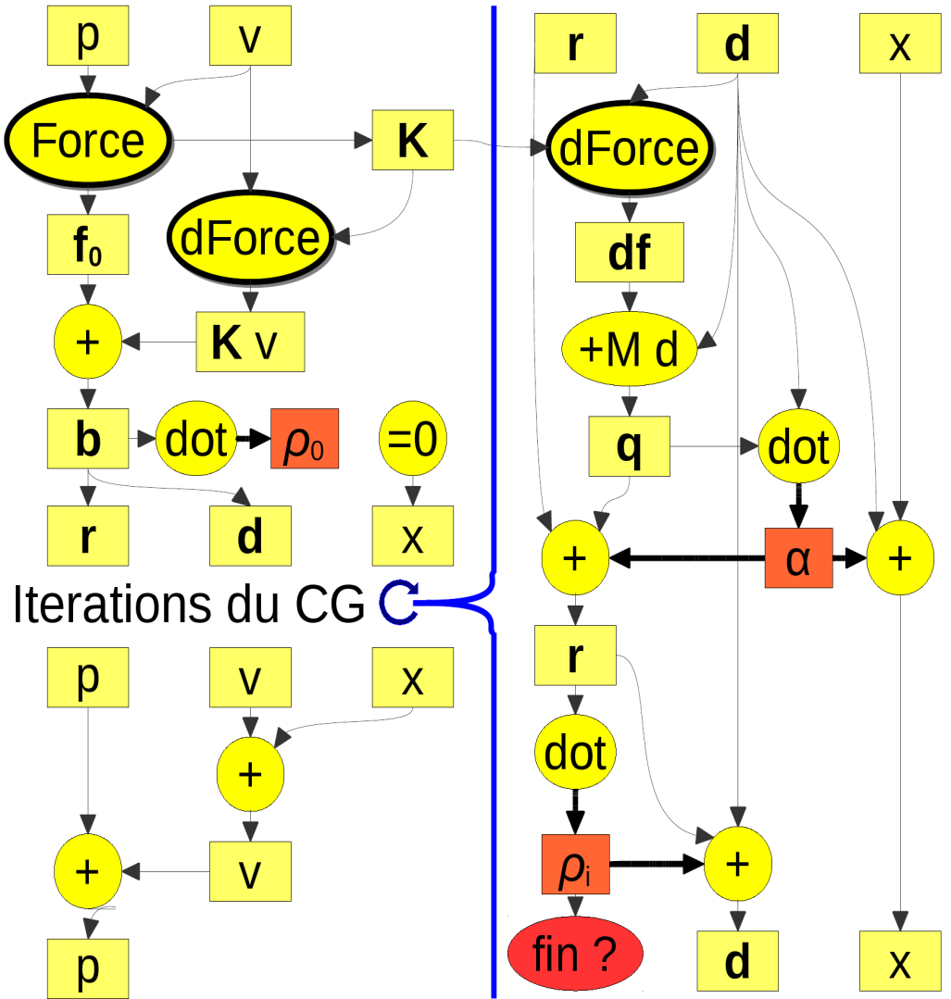
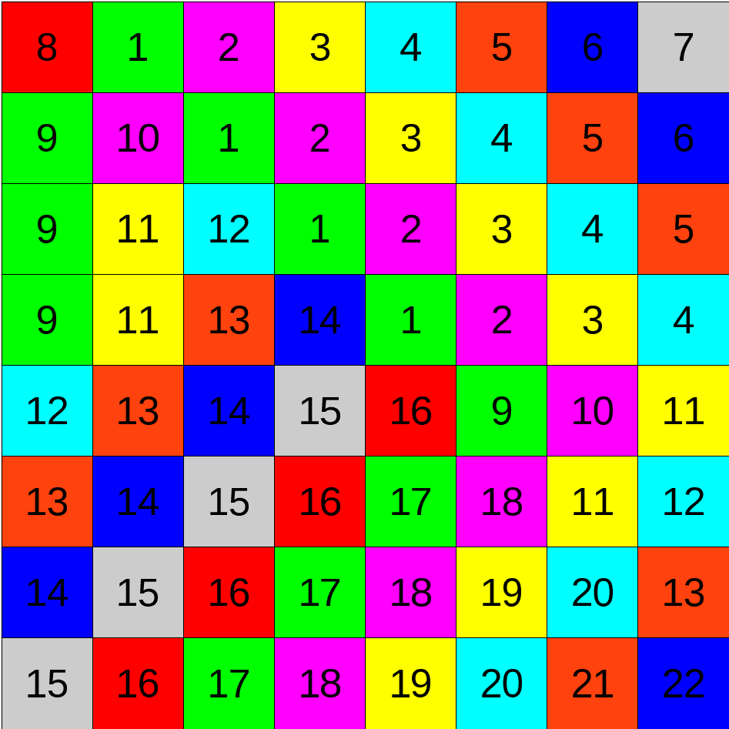
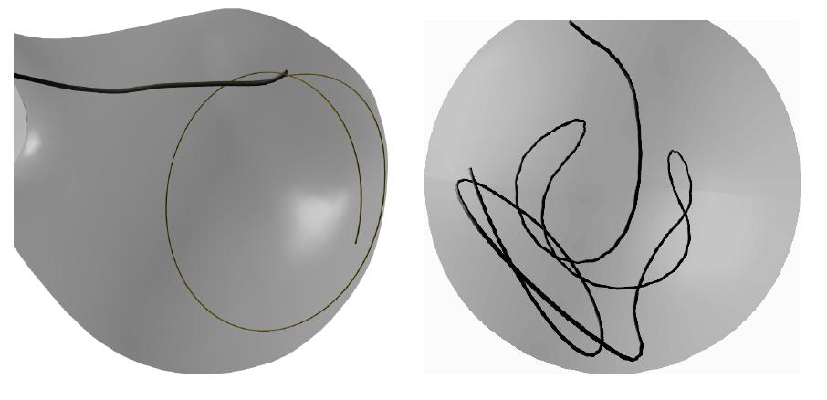
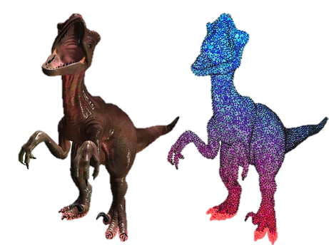
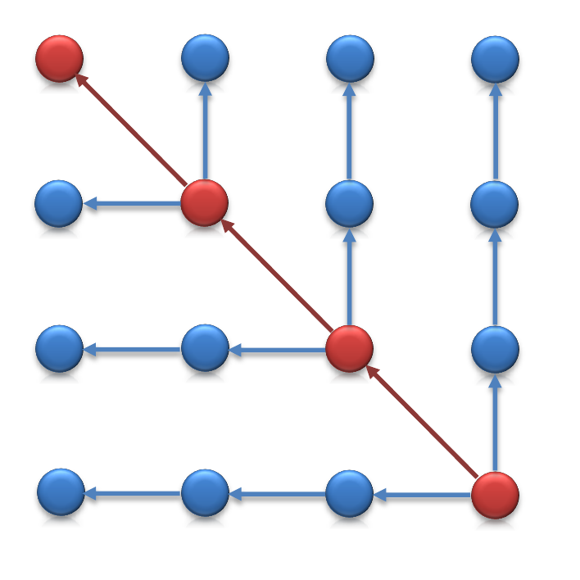
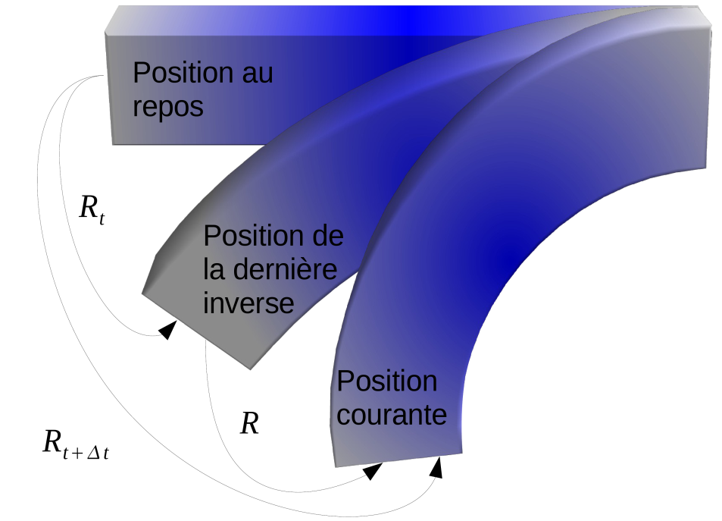
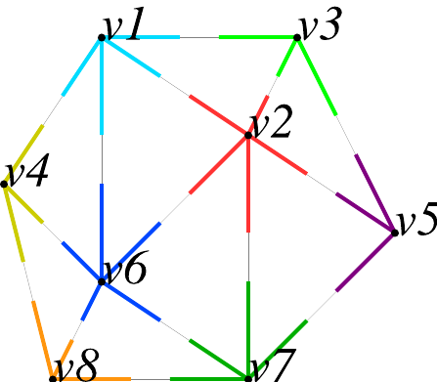
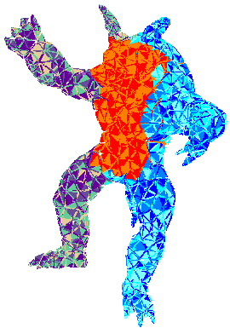
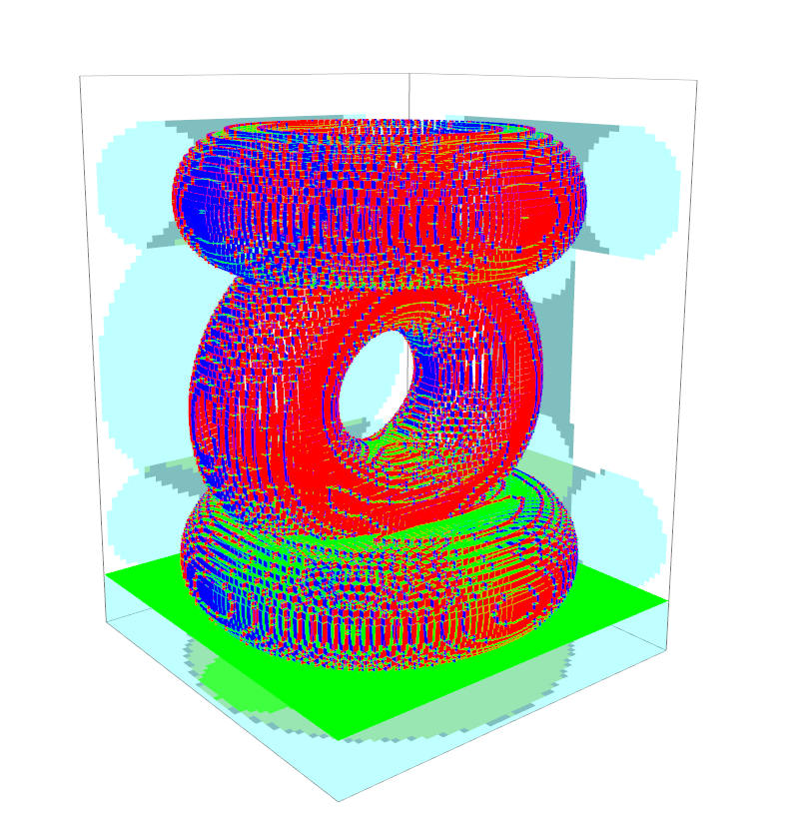
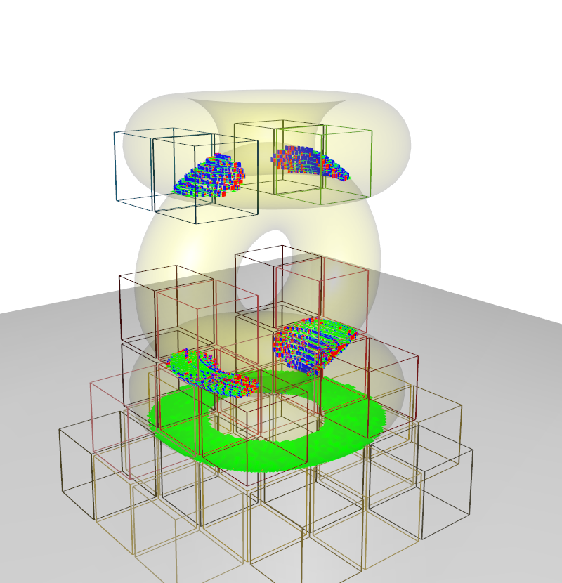
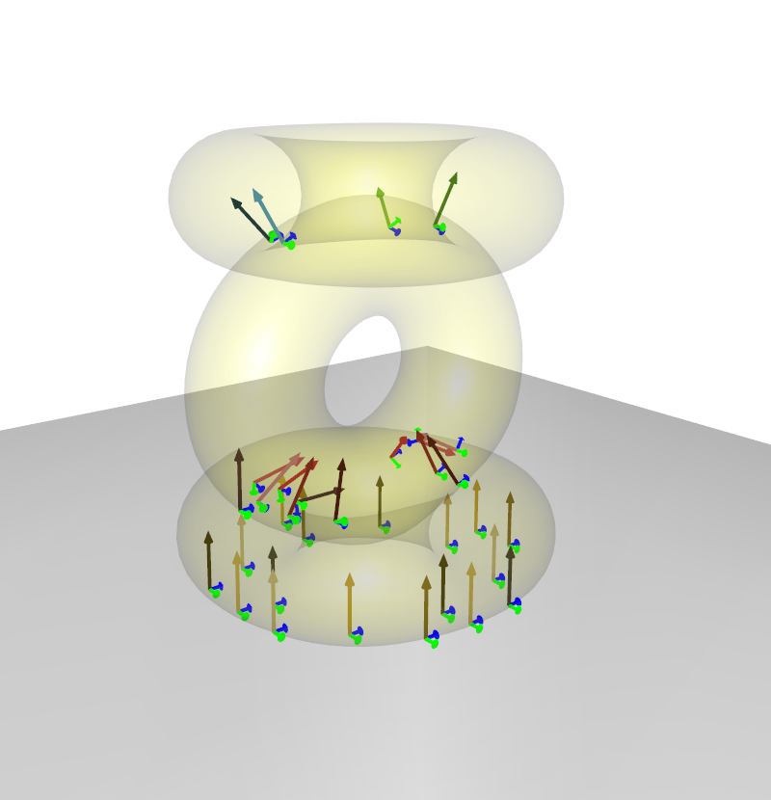
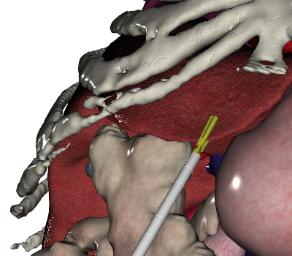
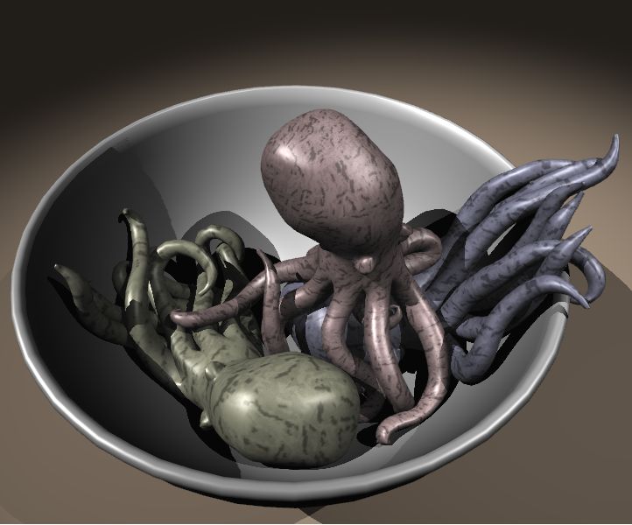
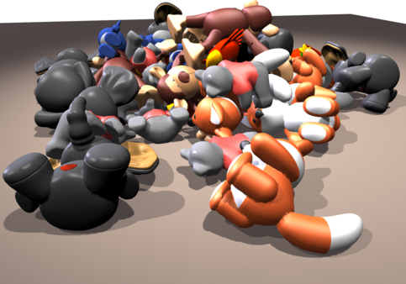
Contributions
GPU parallelization of implicit integrator
Asynchronous preconditioning
Gauss-Seidel parallelization
GPU computation of the compliance for beam model
GPU computation of the compliance based on the preconditioner
Deformation
Collision detection
Contact resolution
Rendering
Collision detection on GPU
Extension to volume constraints

Slide 6
1
2
3
4
5

Slide 7
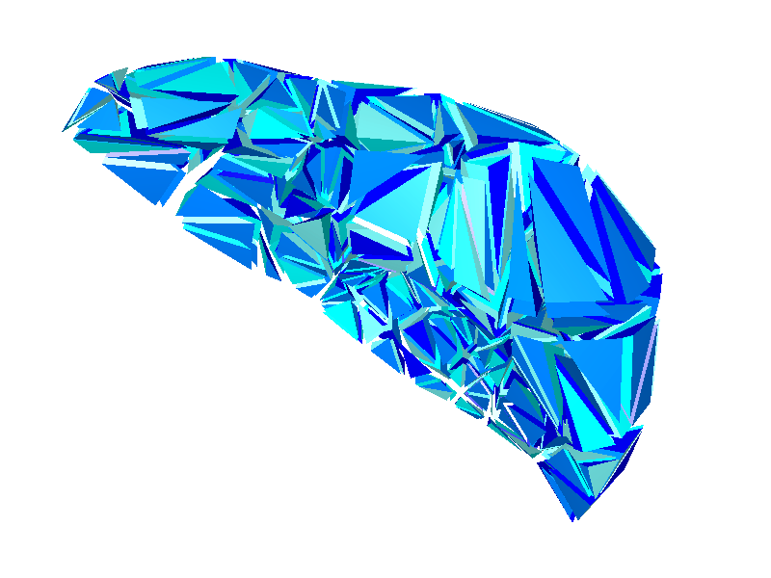
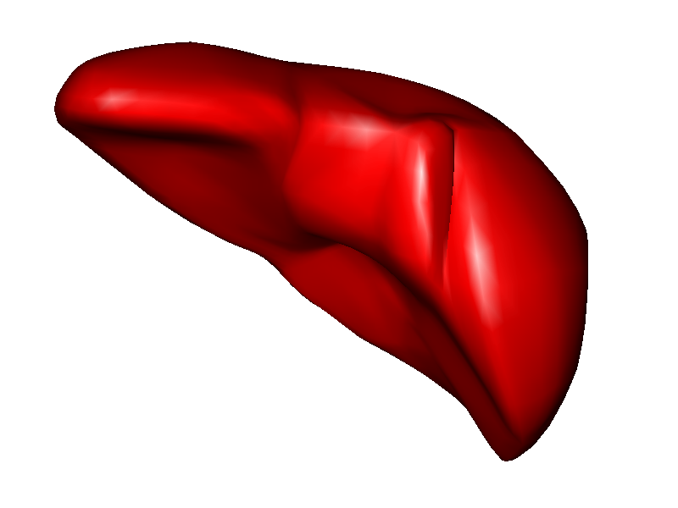
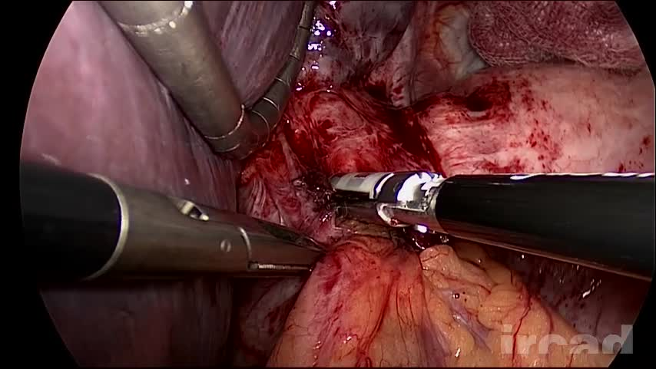
Equations formulation
Continuum mechanics
Assumption of continuity of matter
Based on physics law
Define a deformation model
$$ε=f(σ)$$
$$σ$$
Constitutive law
$$ε$$
$$σ=f^{−1}(ε)$$
Resolution based on finite element method
Discretization in small elements
Integrate and solve equations by elements
Approximation which depends on the size of elements
Stress
Resolution of a dynamic system :
Time evolution of deformable bodies
Involves acceleration, velocity, and position
Strain
Any deformation model describe a relation such as :
$$Ma=f(p,v)$$

Slide 8
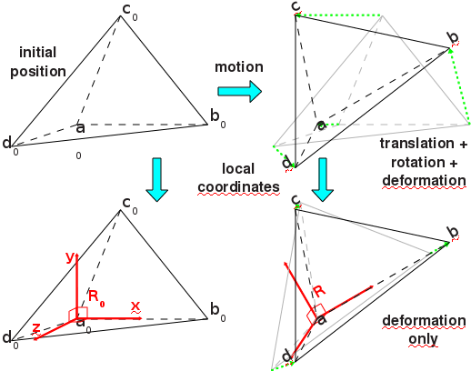
Interactive deformation model
Small displacements and small deformations :
Linear constitutive law
Simple and fast
Inflates for large deformations/displacements
Large displacements and small deformations :
Compensate geometrical non linearity
Take into account the rotations / linear deformation
Co-rotationnal model
Large displacements and large deformations :
Simulation of large deformation
Hyperelastic model :
MJED [Marchesseau et al. 2010]
TLED [Comas et al. 2008]
Difficult to solve in real time
$$σ$$
$$ε$$

Slide 9
Temporal system evolution
Explicit integration :
Local resolution
Fast and parallelizable
Stability implies to use very small time steps
$$f(p_{t},v_{t})$$
$$f(p_{t+h},v_{t+h})$$
$$Ma =$$
$$v_{t+h}= v_{t}+ha$$
$$p_{t+h}= p_{t}+hv_{t+h}$$
Implicit integration :
Update the acceleration from position and velocity at the end of the time step
Stable with large time steps
Linearization of $f$ around the initial position [Baraff et al. 1998]
$$f\left(p_{t+h},v_{t+h}\right)=f\left(p_{t},v_{t}\right)+K∙\left(p_{t+h}−p_{t}\right)+B∙(v_{t+h}−v_{t})$$
Rearranging equations gives the linear system :
$$\left(M−hB−h^{2}K\right) dv=hf\left(p_{t},v_{t}\right)+h^{2}Kv_{t}$$
$$A x = b$$
Problem 1 : How to solve $A x=b$ in real time ?

Slide 10
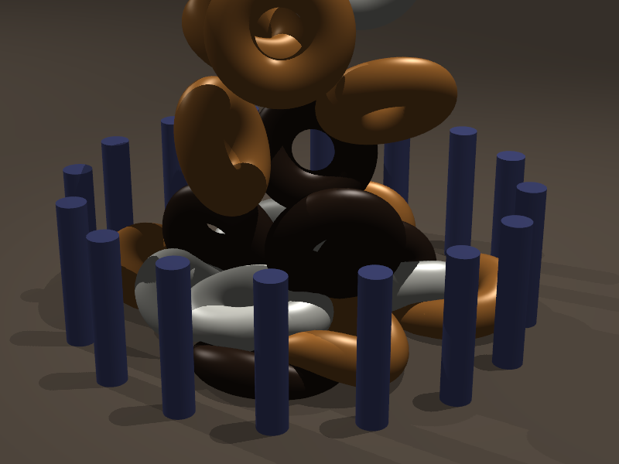
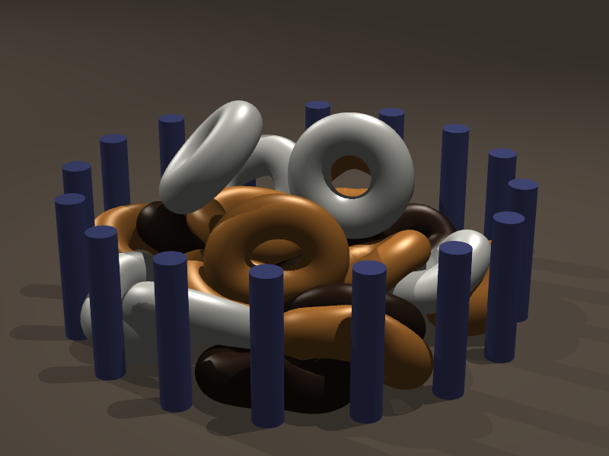
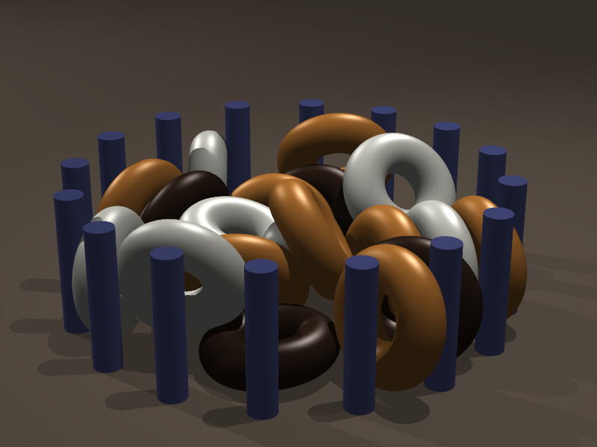
Collision detection
Problem 2 : How to detect collisions in real time ?
Collision detection :
Find primitives in intersection or close to intersection
Many different methods [Teschner et al. 2005]
Bounding volume hierarchy
Distance field
GPU based methods
Medical simulation implies :
Handle Complex geometries and deformable objects
Handle topological modifications (cutting)
Handle self-collisions
Handle friction/grasping
Keep simple formulation for the response

Slide 11
Collision response
Problem 3 : How to handle mechanical coupling in real time ?
Signorini law to build a LCP (Linear Complementary Problem)
$$δ=H{(\frac{1}{h²}M+\frac{1}{h}B+K)}^{−1}H^{T} λ+δ_{0}$$
with $0≤ δ⊥λ≥0$
Compliance
dt=0,01
Solved with a Gauss-Seidel method [Courtecuisse et al., HPCC 2009]
Find $λ$ which solves interactions

Slide 12
Previous solutions
Compliance Warping [Saupin et al. 2008]
1500 elements
Only the liver is simulated
Response based on pre-computations
Simplified model
Objectives :
Increase the number of elements
Add other organs
Handle cutting
Better mechanical coupling
Real time constraints

Slide 13
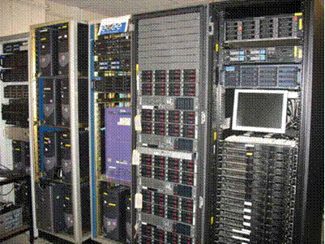
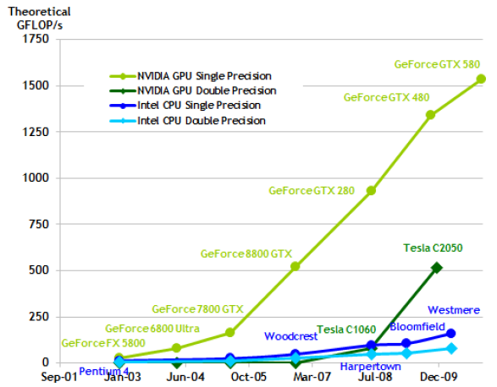
New parallel architectures
Difficult to increase the frequency of processors
Parallelization of algorithms
Parallelization of a simulation is not a new idea :
Parallel processors, distributed processors, …
Real time simulation constraints :
A lot of very fast computations
Use GPU to achieve computations (GPGPU).

Slide 14
GPU architecture
GPU is seen as a specialized co-processeur :
Achieve high parallel tasks
CPU
GPU
Grille 1
Two level of parallelism :
A Grid contains several blocs
A Block contains several threads
Kernel 1
Block
(0,0)
Block
(1,0)
Blobk
(2,0)
Block
(0,1)
Block
(1,1)
Block
(1,2)
GPU programing :
Local synchronisations very fast
Global synchronisations very slow (Synchronisation with the CPU)
Kernel 2
Grille 2
Block (1,1)
GPU Parallelization strategies are very different than CPU parallelization :
Run thousand of threads to exploit efficiently the GPU
Thread
(0,0)
Thread
(1,0)
Thread
(2,0)
Thread
(3,0)
Thread
(4,0)
Thread
(0,1)
Thread
(1,1)
Thread
(2,1)
Thread
(3,1)
Thread
(4,1)
Thread
(0,2)
Thread
(1,2)
Thread
(2,2)
Thread
(3,2)
Thread
(4,3)

Slide 15
Deformation
Collision detection
1
Contacts resolution
Simulation rendering
2
GPU parallelization of implicit integrator
Asynchronous preconditioning
3
4
5

Slide 16
Solving methods
Problem 1 : How to solve $A x=b$ in real time ?
Pre-compute the inverse of the system :
Actually compute $A^{−1}$such as ${x=A}^{−1}b$
Benefits: Fast
Disadvantages: Limited to linear and to coarse models [Cotin et al. 96]
Compute a factorization :
${A=L D L}^{T}$ or ${A=L L}^{T}$ (Cholesky factorization)
Benefits: Stable and accurate, sparse factorization can be applied for detailed meshes
Disadvantages: Time to factorize is important
Use an iterative algorithm :
Conjugate Gradient algorithm (CG) [Baraff et al. 1998]
Benefits: Possible to stop computations as soon as the desired precision is achieved
Disadvantages: Convergence problems

Slide 17
GPU-based implicit integration
Parallelization of implicit integration [Allard et al. 2011, GPU Gems]
Only two scalar and must be transferred between CPU and GPU to check convergence
$$α$$
$$ρ_{i}$$
Most of operations and are linear algebra operations
Parallelization solutions exists
+
dot
Only and are not linear algebra operations
Accumulate forces on each DOF
$\left(M−hB−h^{2}K\right) dv=hf\left(p_{t},v_{t}\right)+h^{2}Kv_{t}$
Force
dForce
GPU
CPU

Slide 18
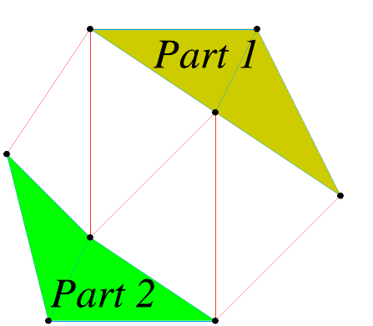
Implicite solver on GPU
Accumulate forces on each points
Independent of the deformation model
Dependences between edges
Parallelization methods :
Graph partitioning [Hermann et al. 2010]
Small number of processors
Graph coloration [PhysX, Bullet]
Graph very sparse, analysis of the graph
Treat each DOF in parallel
Assign an unique ID to each edge
Pre-compute neighbourhood associations
Require one global synchronisation
0
4
Kernel1
1
2
3
Vecteur temporaire :
Synchronisation
Kernel2
Vecteur pré-calculé :
$$\overset{Noeuds 0}{\overbrace{\begin{matrix}0 & 3 & 6\end{matrix}}}$$
$\overset{Noeuds 1}{\overbrace{\begin{matrix}1 & −1 & −1\end{matrix}} }$
$\overset{Noeuds 2}{\overbrace{\begin{matrix}2 & 4 & −1\end{matrix}} }$
$\overset{Noeuds 3}{\overbrace{\begin{matrix}5 & 7 & −1\end{matrix}} }$
$$\overset{Noeuds 4}{\overbrace{\begin{matrix}8 & −1 & −1\end{matrix}}}$$

Slide 19
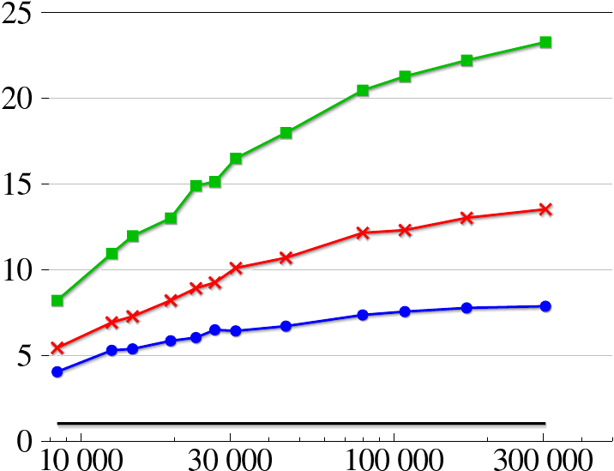
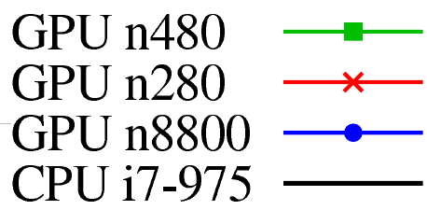
Performances evaluation
Speedup between 5 to 25
Simulate 300 000 elements in real time (CG limited to 25 iterations)
Nombre
Speedup
Number of elements

Slide 20
Asynchronous preconditioner
High number of iterations for ill conditioned problems
Non homogeneous objects
Non uniform meshes

Slide 21
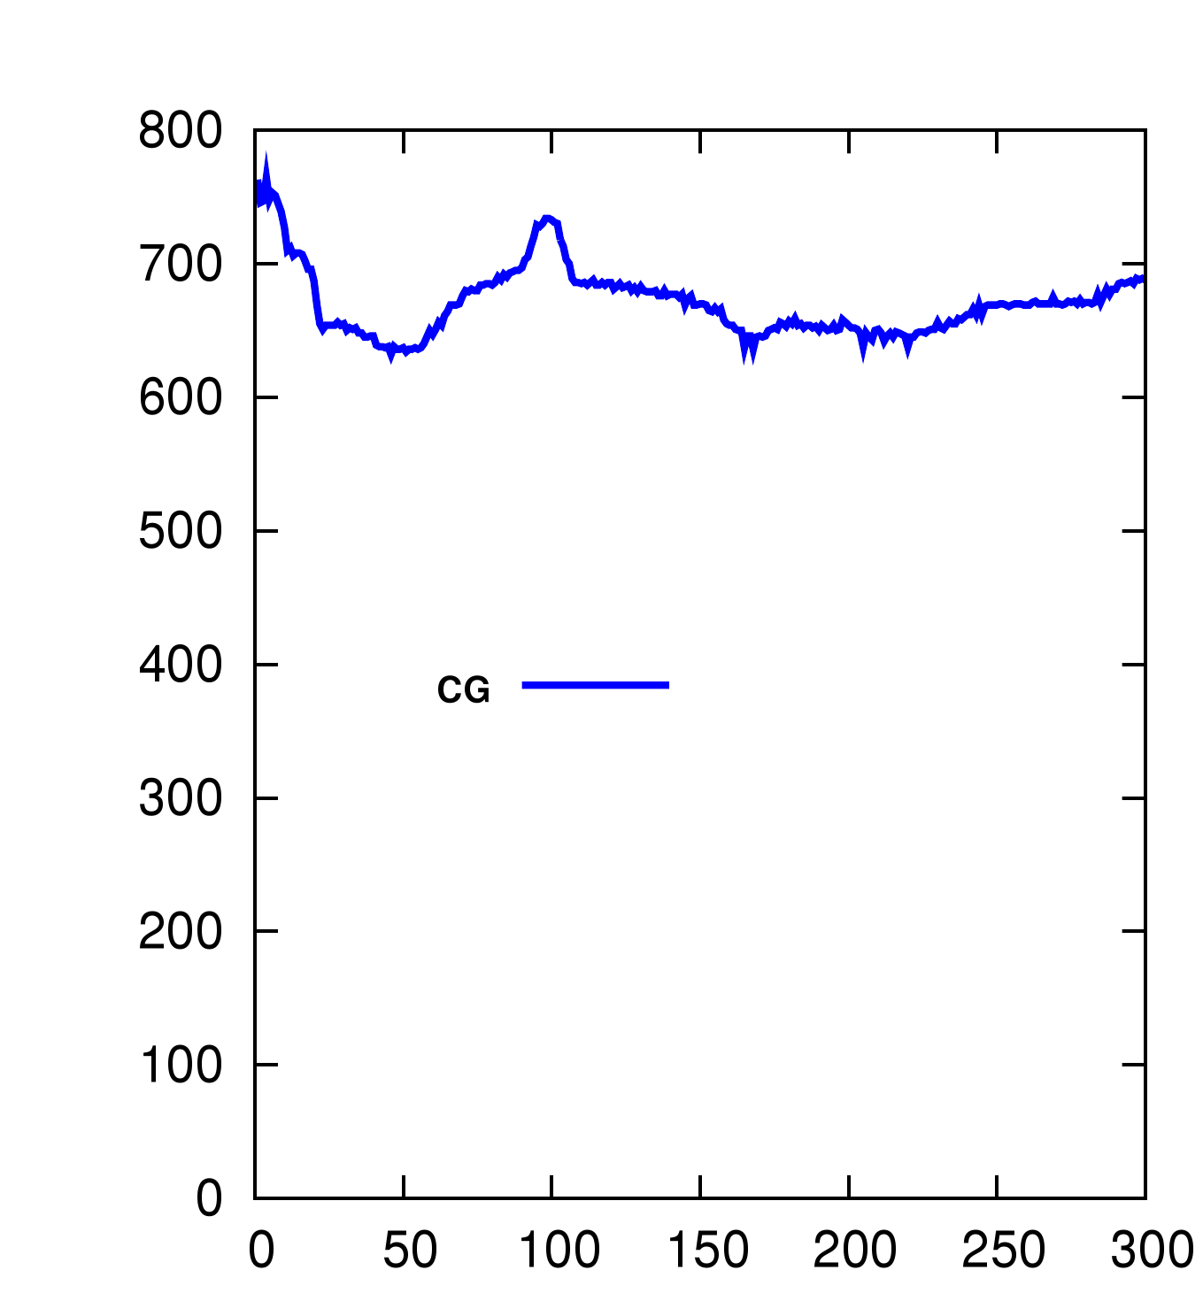
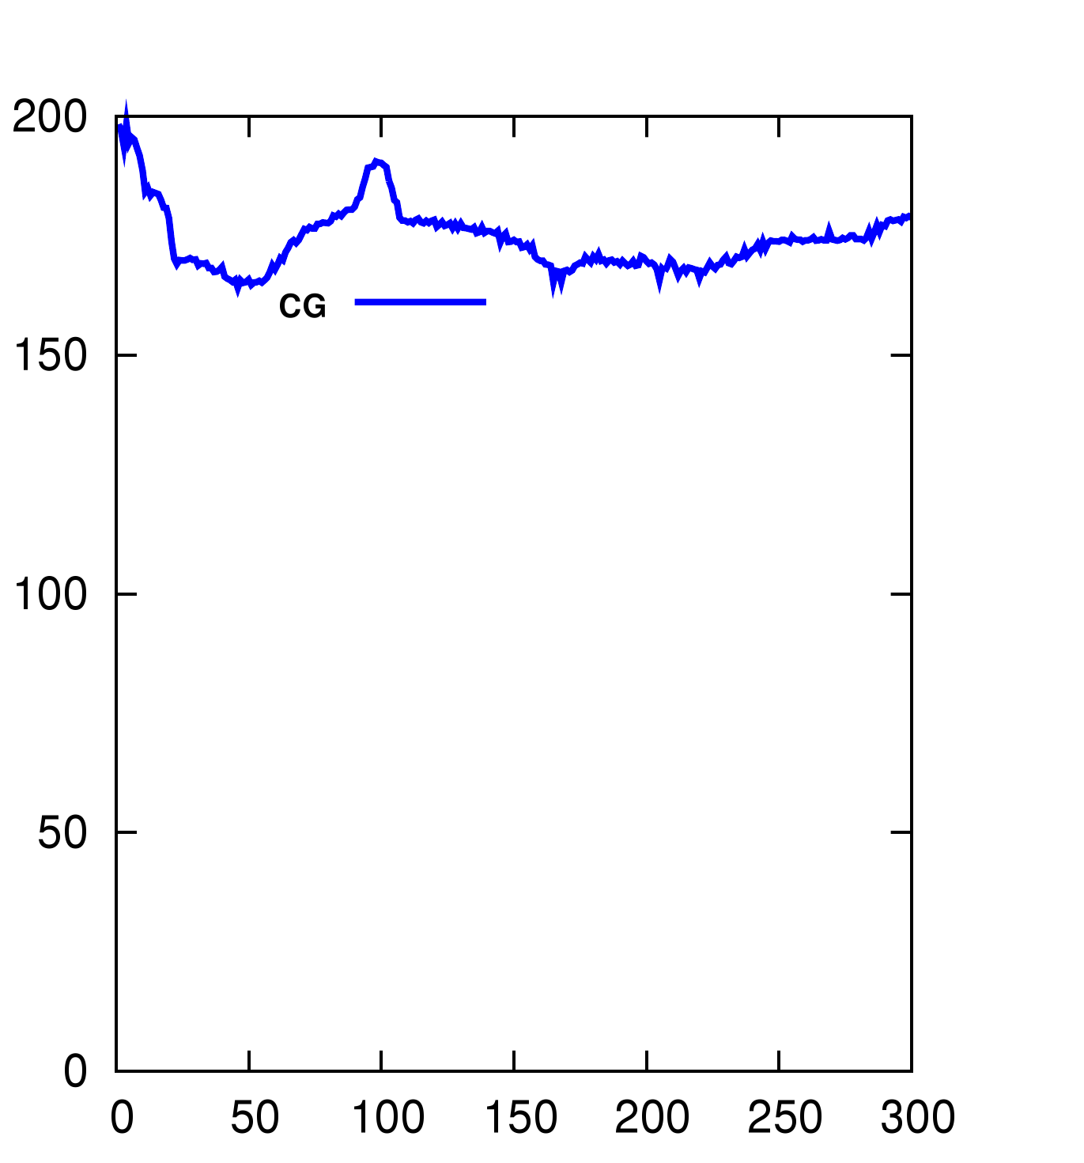
Asynchronous preconditioner
Number of iterations
Computation time (ms)

Slide 22
Asynchronous preconditioner
High number of iterations for ill conditioned problems
Non homogeneous objects
Non uniform meshes
Use a preconditioner :
Approximation of the system which is easier to invert
S
New FEM Computation
Precond
Computation
$$A x=$$
$$b$$
$P^{−1} P^{−1}$
$$≈I$$
CG
Iterations
Fast convergence with additional overheads
Overhead to inverse the preconditioner
Overhead to apply the preconditioner at each iteration
Precond
Application

Slide 23
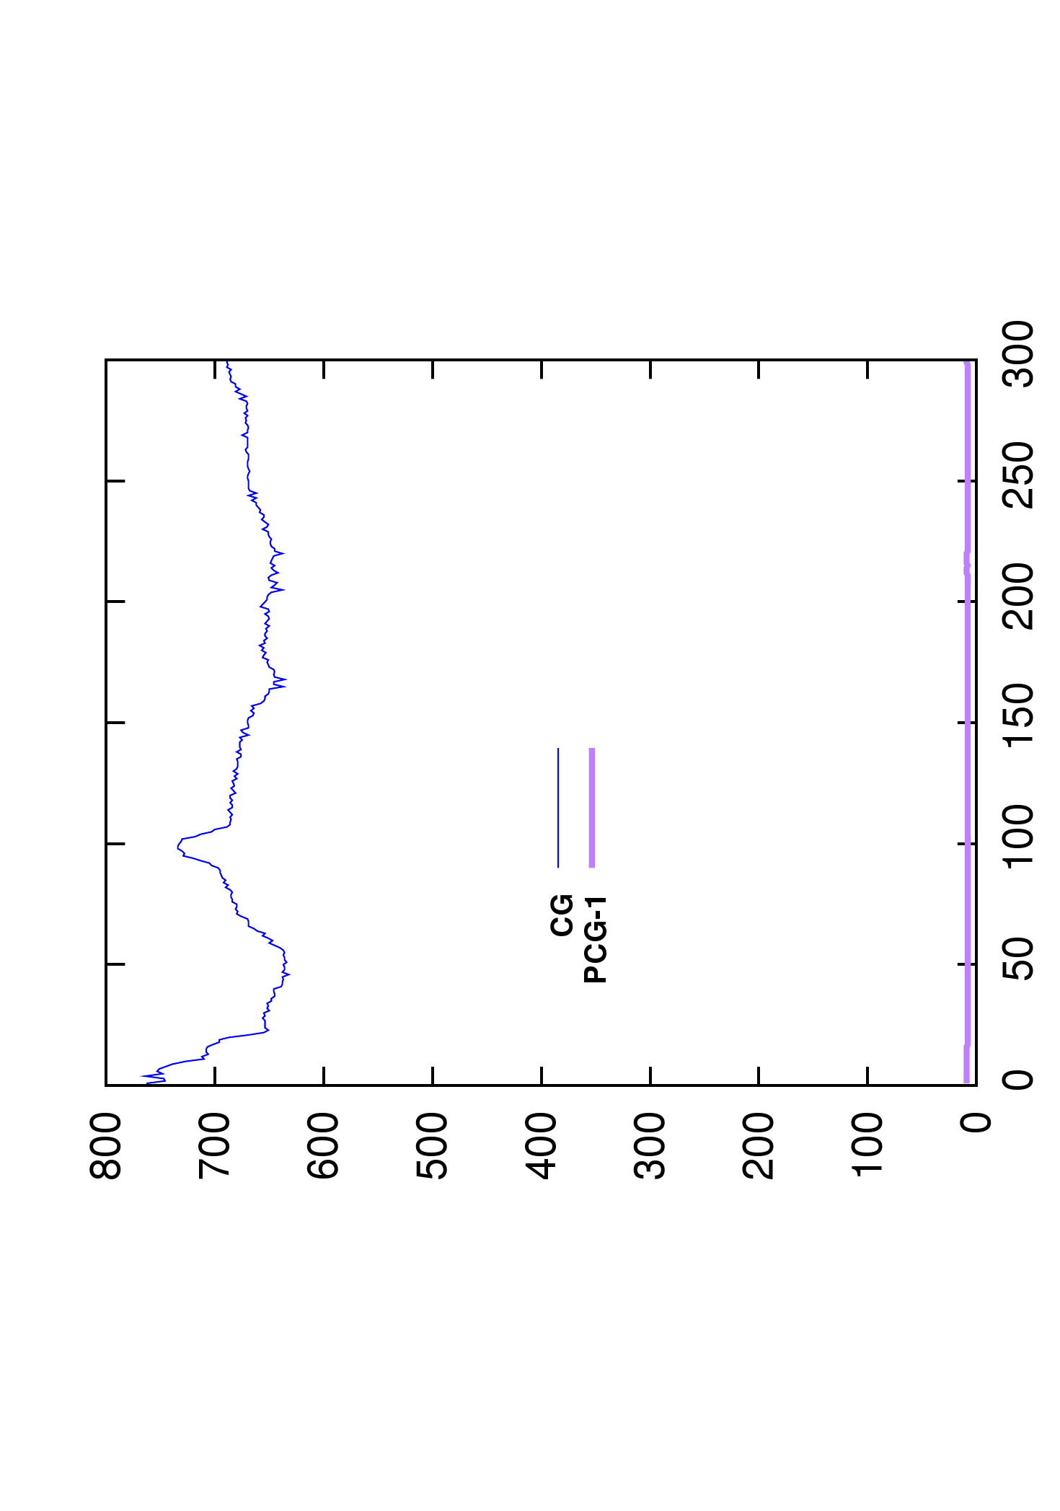
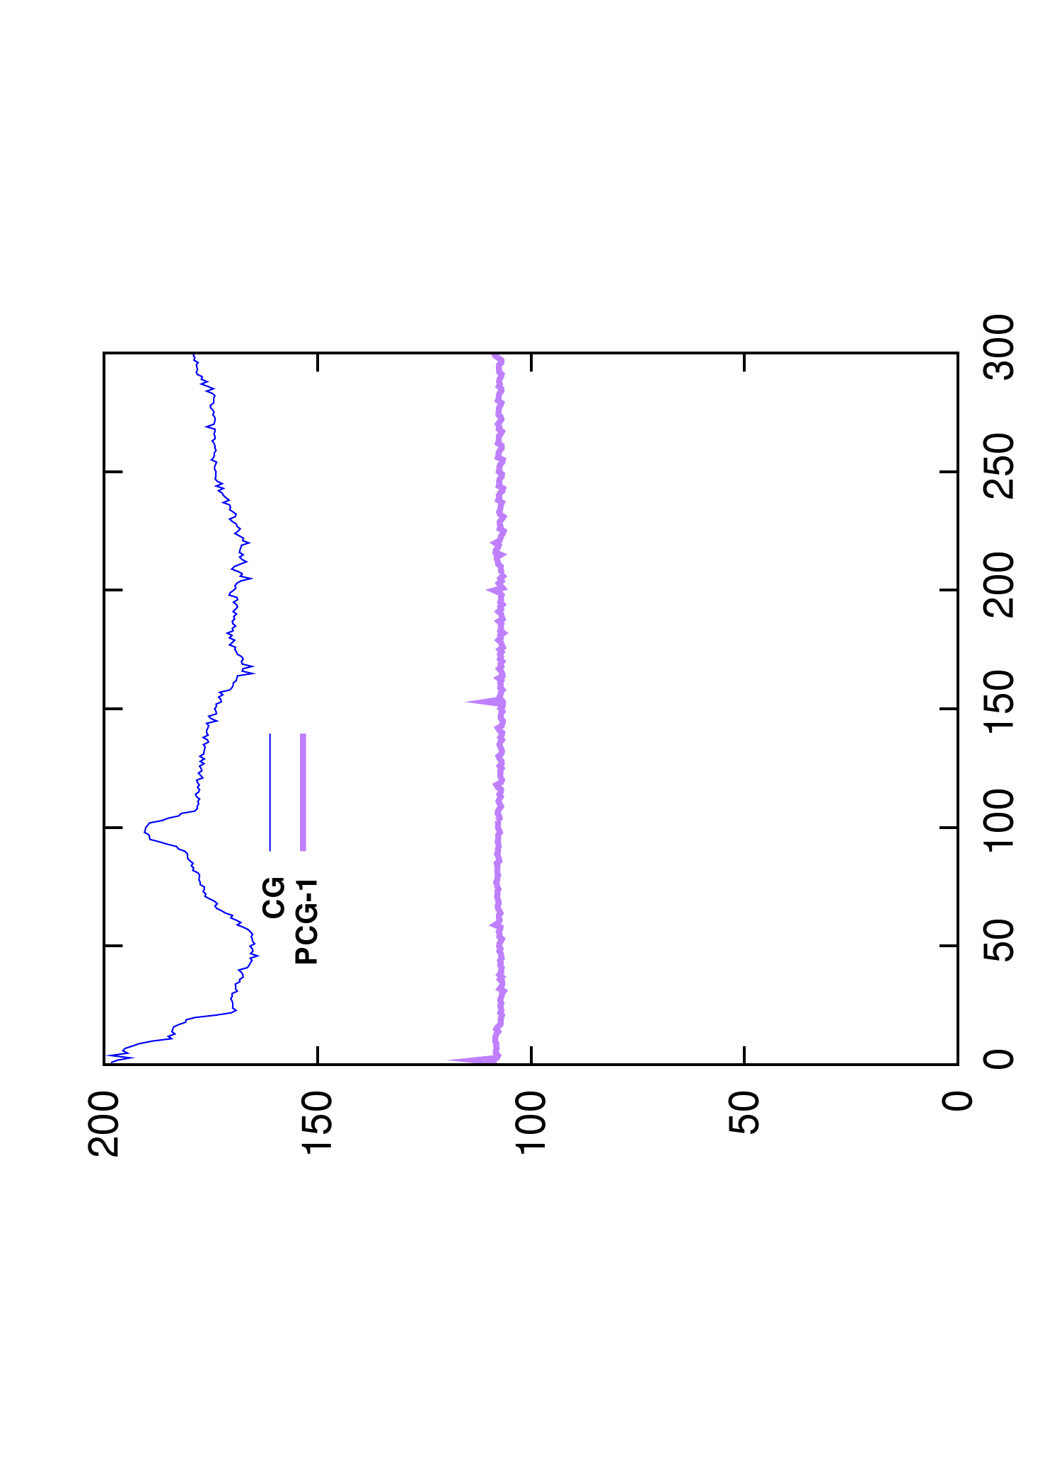
Asynchronous preconditioner
Number of iterations
Computation time (ms)

Slide 24
Asynchronous preconditioner
High number of iterations for ill conditioned problems
Non homogeneous objects
Non uniform meshes
Use a preconditioner :
Approximation of the system which is easier to invert
S
New FEM Computation
Precond
Computation
$$A x=$$
$$b$$
$P^{−1} P^{−1}$
$$≈I$$
CG
Iterations
Fast convergence with additional overheads
Overhead to inverse the preconditioner
Overhead to apply the preconditioner at each iteration
Exploit time coherency between time steps
Precond
Application

Slide 25
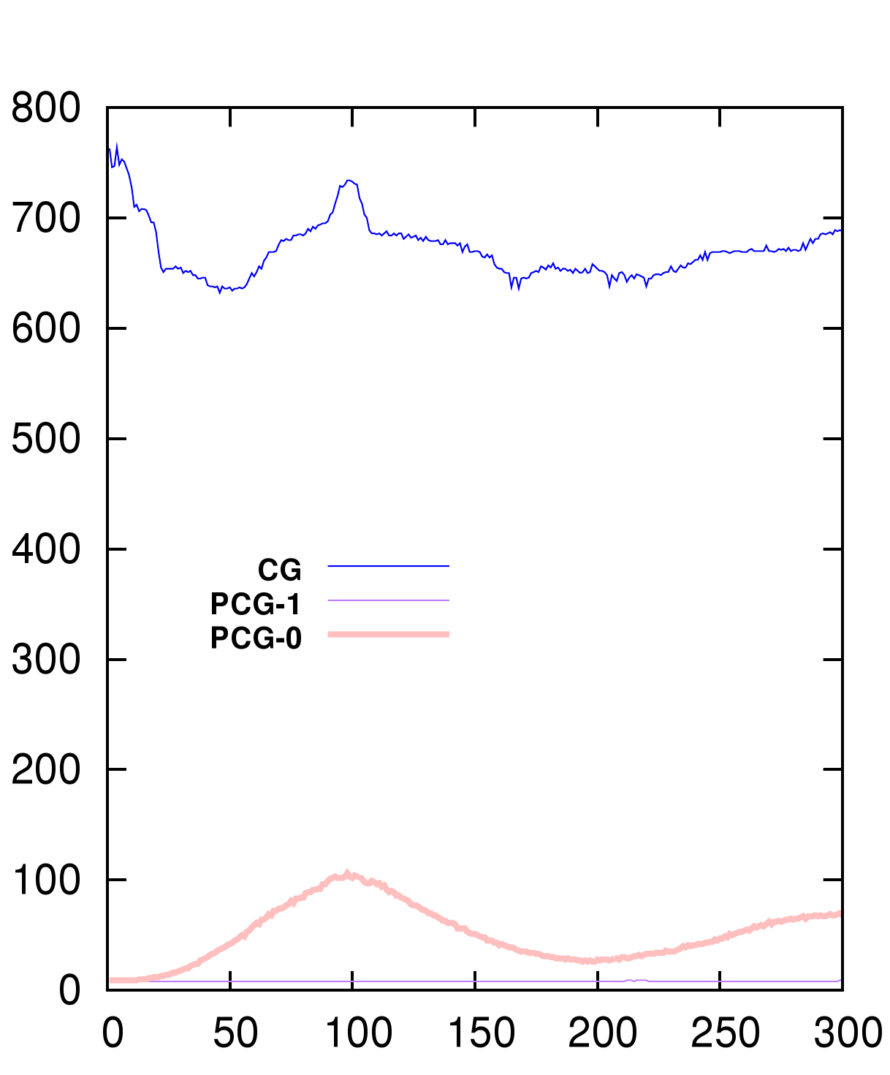
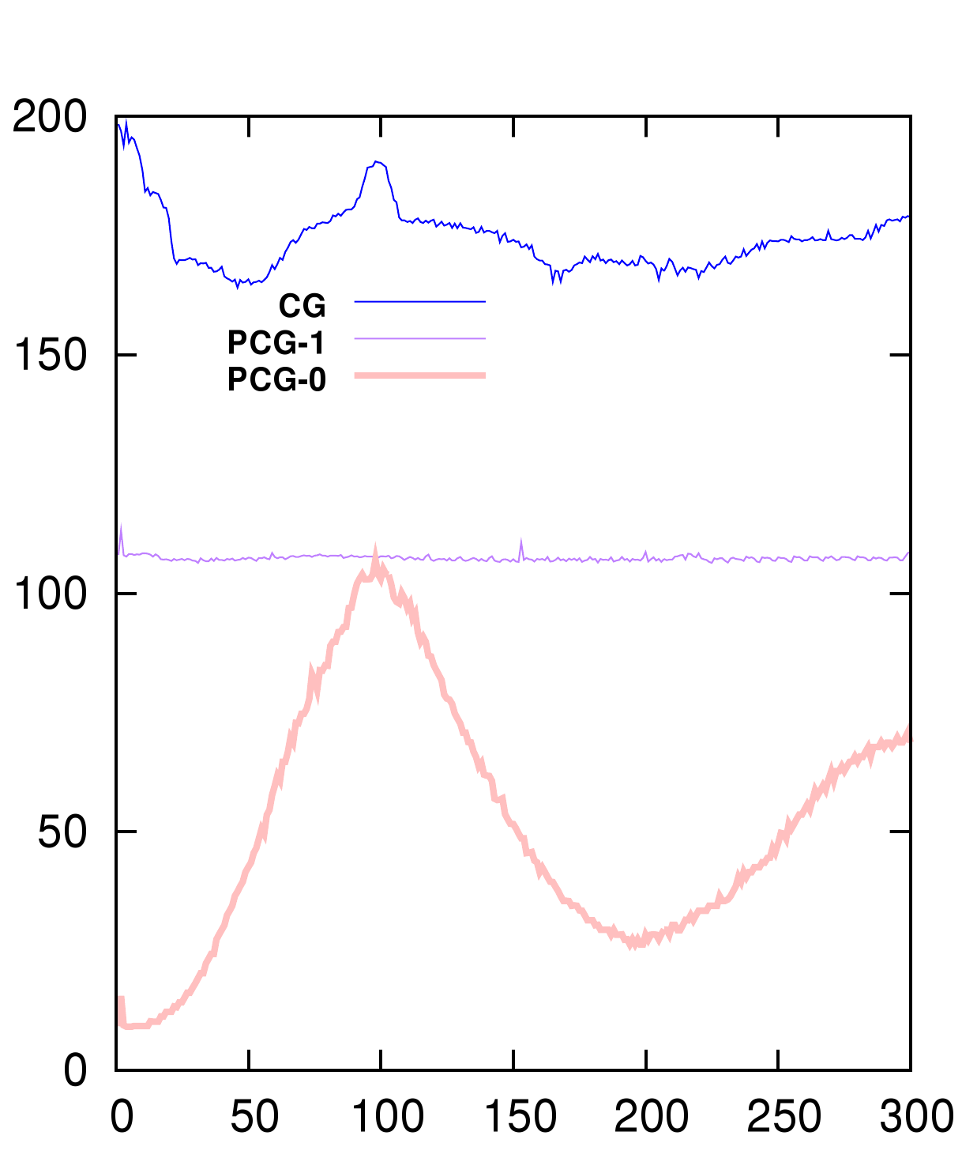
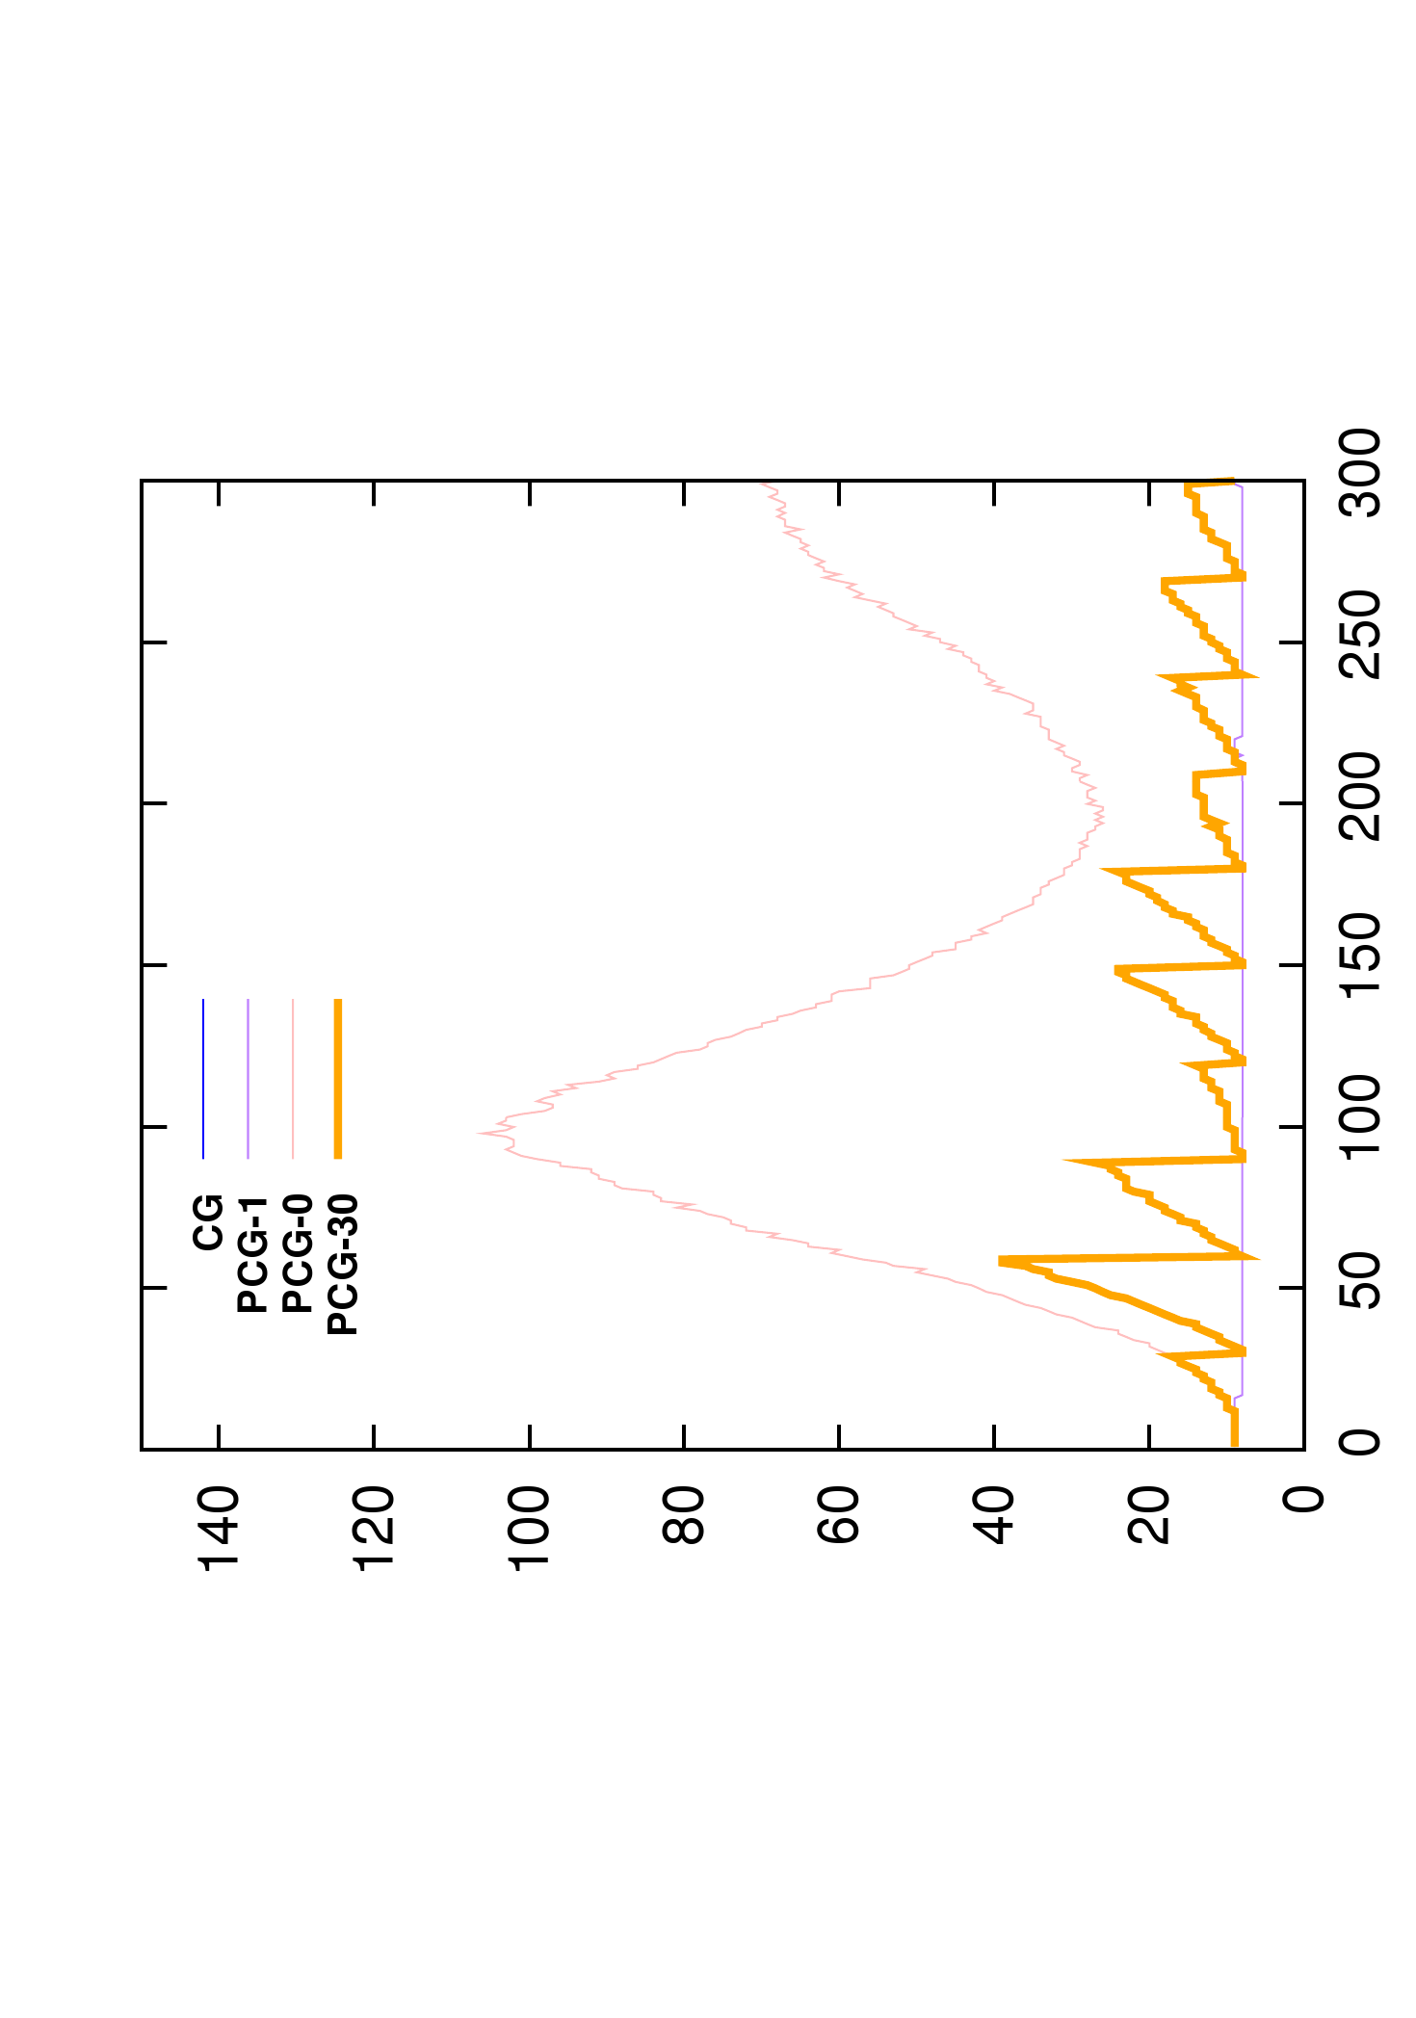
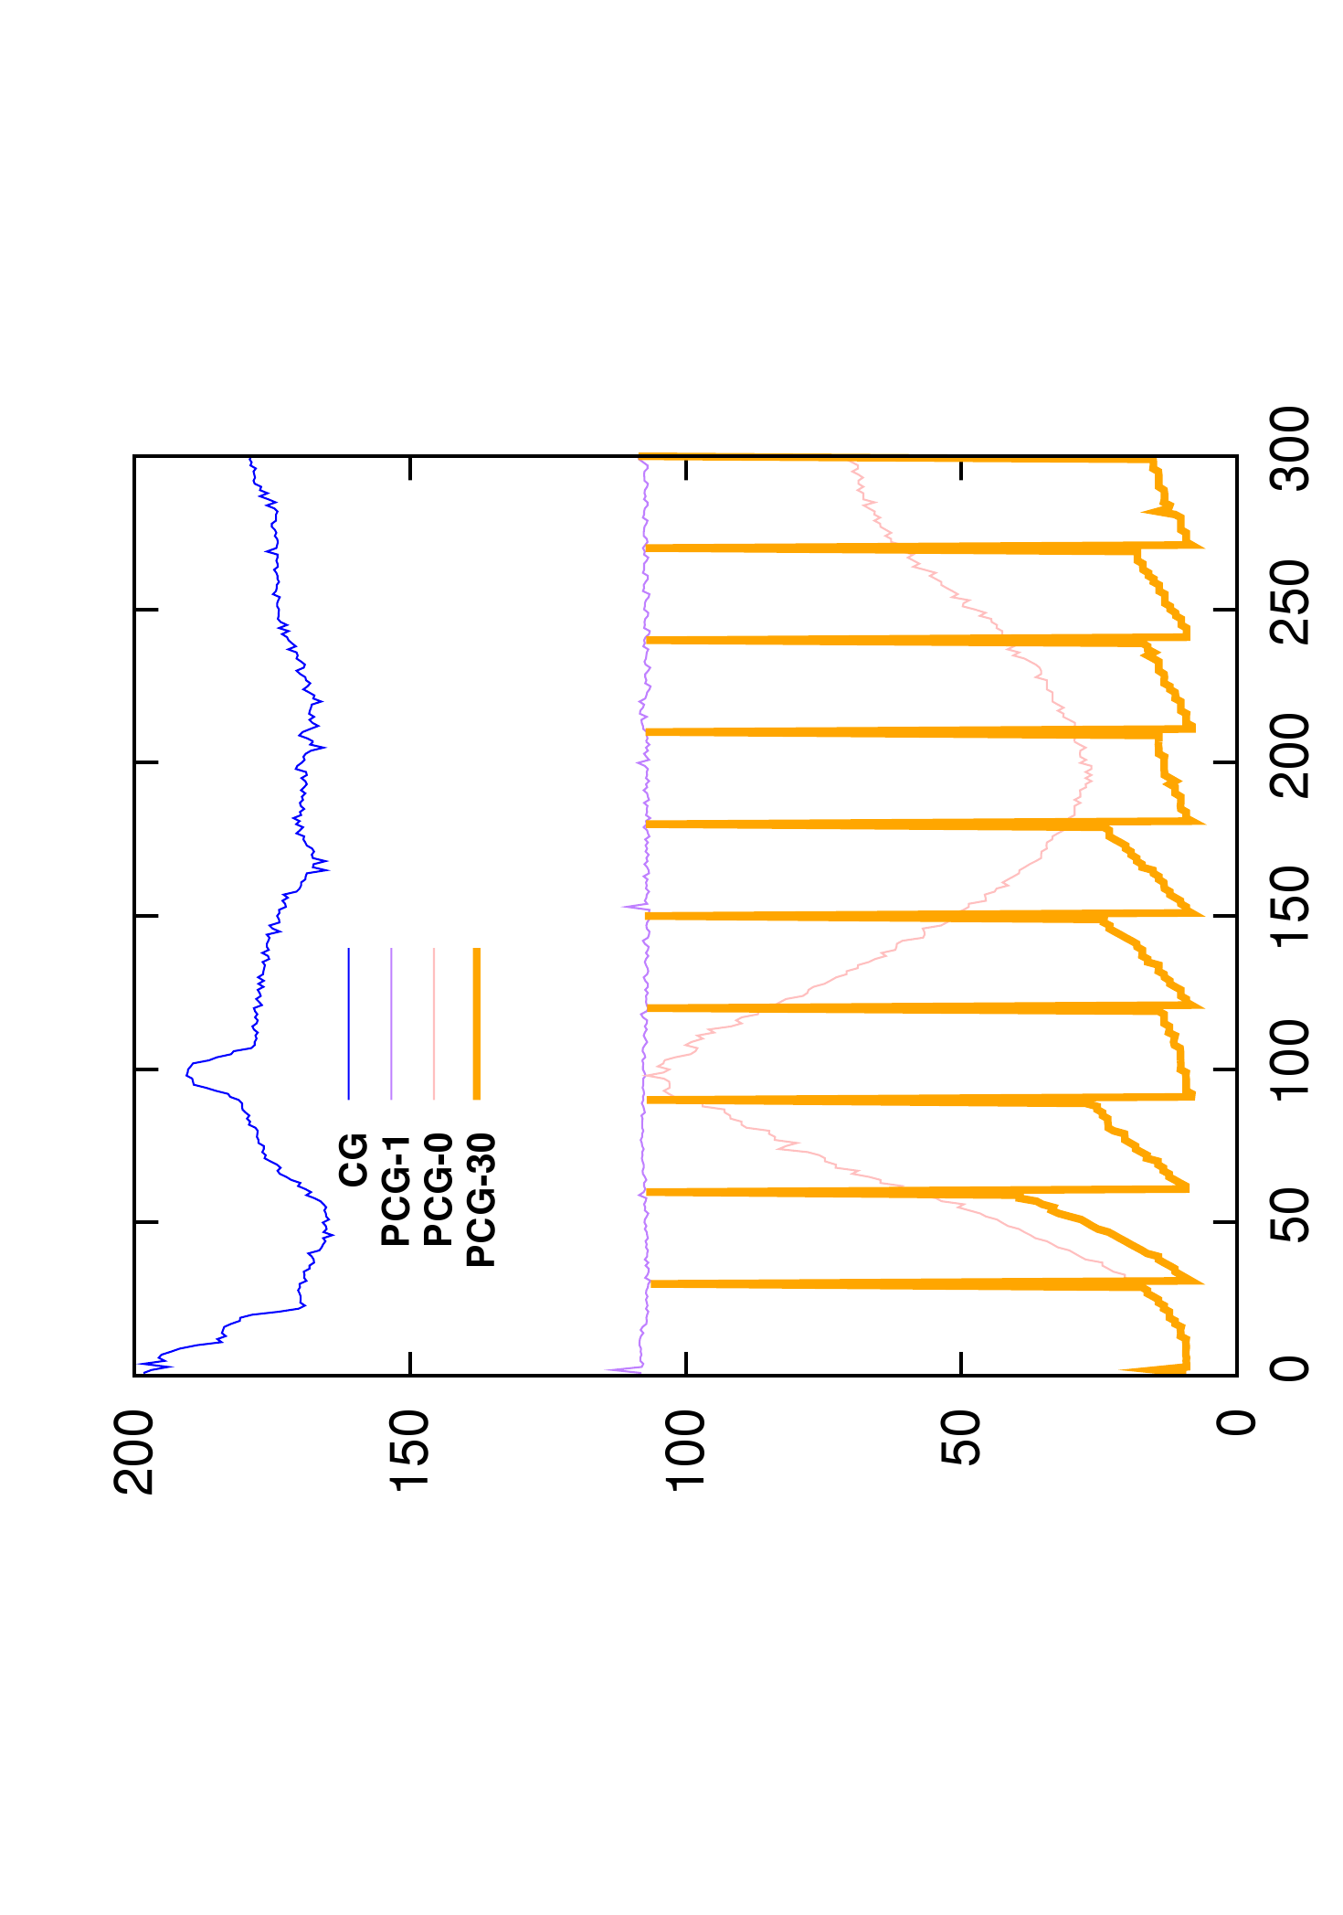
Asynchronous preconditioner
Number of iterations
Computation time (ms)

Slide 26
Asynchronous preconditioner
High number of iterations for ill conditioned problems
Non homogeneous objects
Non uniform meshes
Use a preconditioner :
Approximation of the system which is easier to invert
S
New FEM Computation
Synchronization
Precond
Computation
$$A x=$$
$$b$$
$P^{−1} P^{−1}$
$$≈I$$
CG
Iterations
Fast convergence with additional overheads
Overhead to inverse the preconditioner
Overhead to apply the preconditioner at each iteration
Exploit time coherency between time steps
Precond
Application

Slide 27
Asynchronous preconditioner
Update the preconditioner periodically [Courtecuisse et al. 2010, Vriphys]
$$Use P_{t−Δt}^{−1}$$
$$Use P_{t}^{−1}$$
Simulation
Step
Simulation
Step
Simulation
Step
Simulation
Step
Simulation
Step
Simulation
Step
Simulation
Step
Simulation
Step
Simulation
Step
Simulation
Step
Simulation
Step
Simulation
Step
Notification
Synchronization
Notification
Synchronization
Notification
Synchronization
$$Compute{ P}_{t}$$
$Compute P_{t+Δt}$
Enable to use advanced preconditioners :
Use an exact factorization of the system $P=LDL^{T}$
$L$ remains sparse and can be applied to detailed meshes

Slide 28
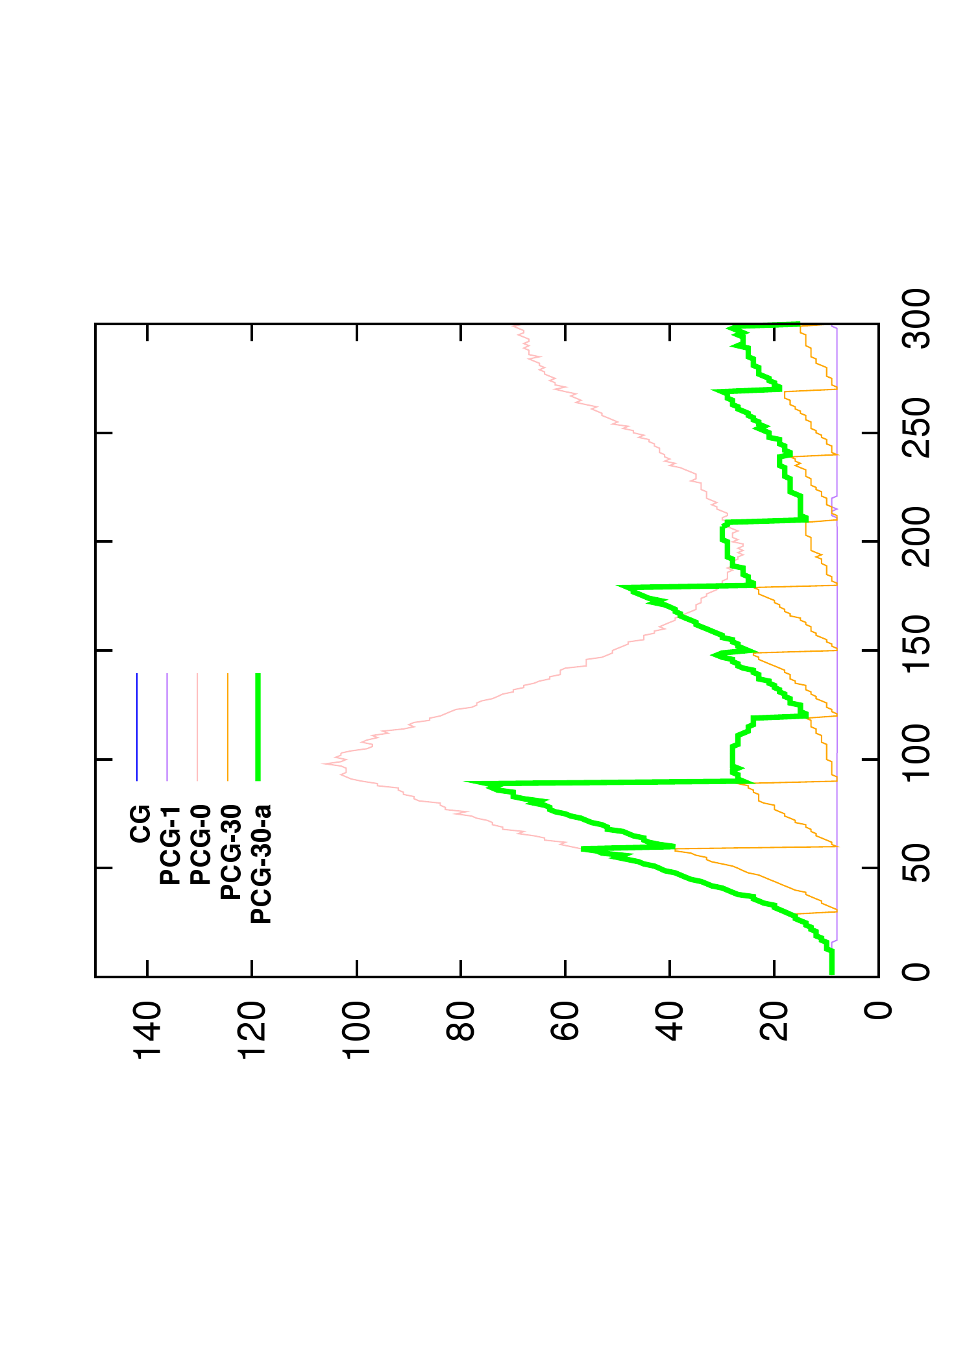
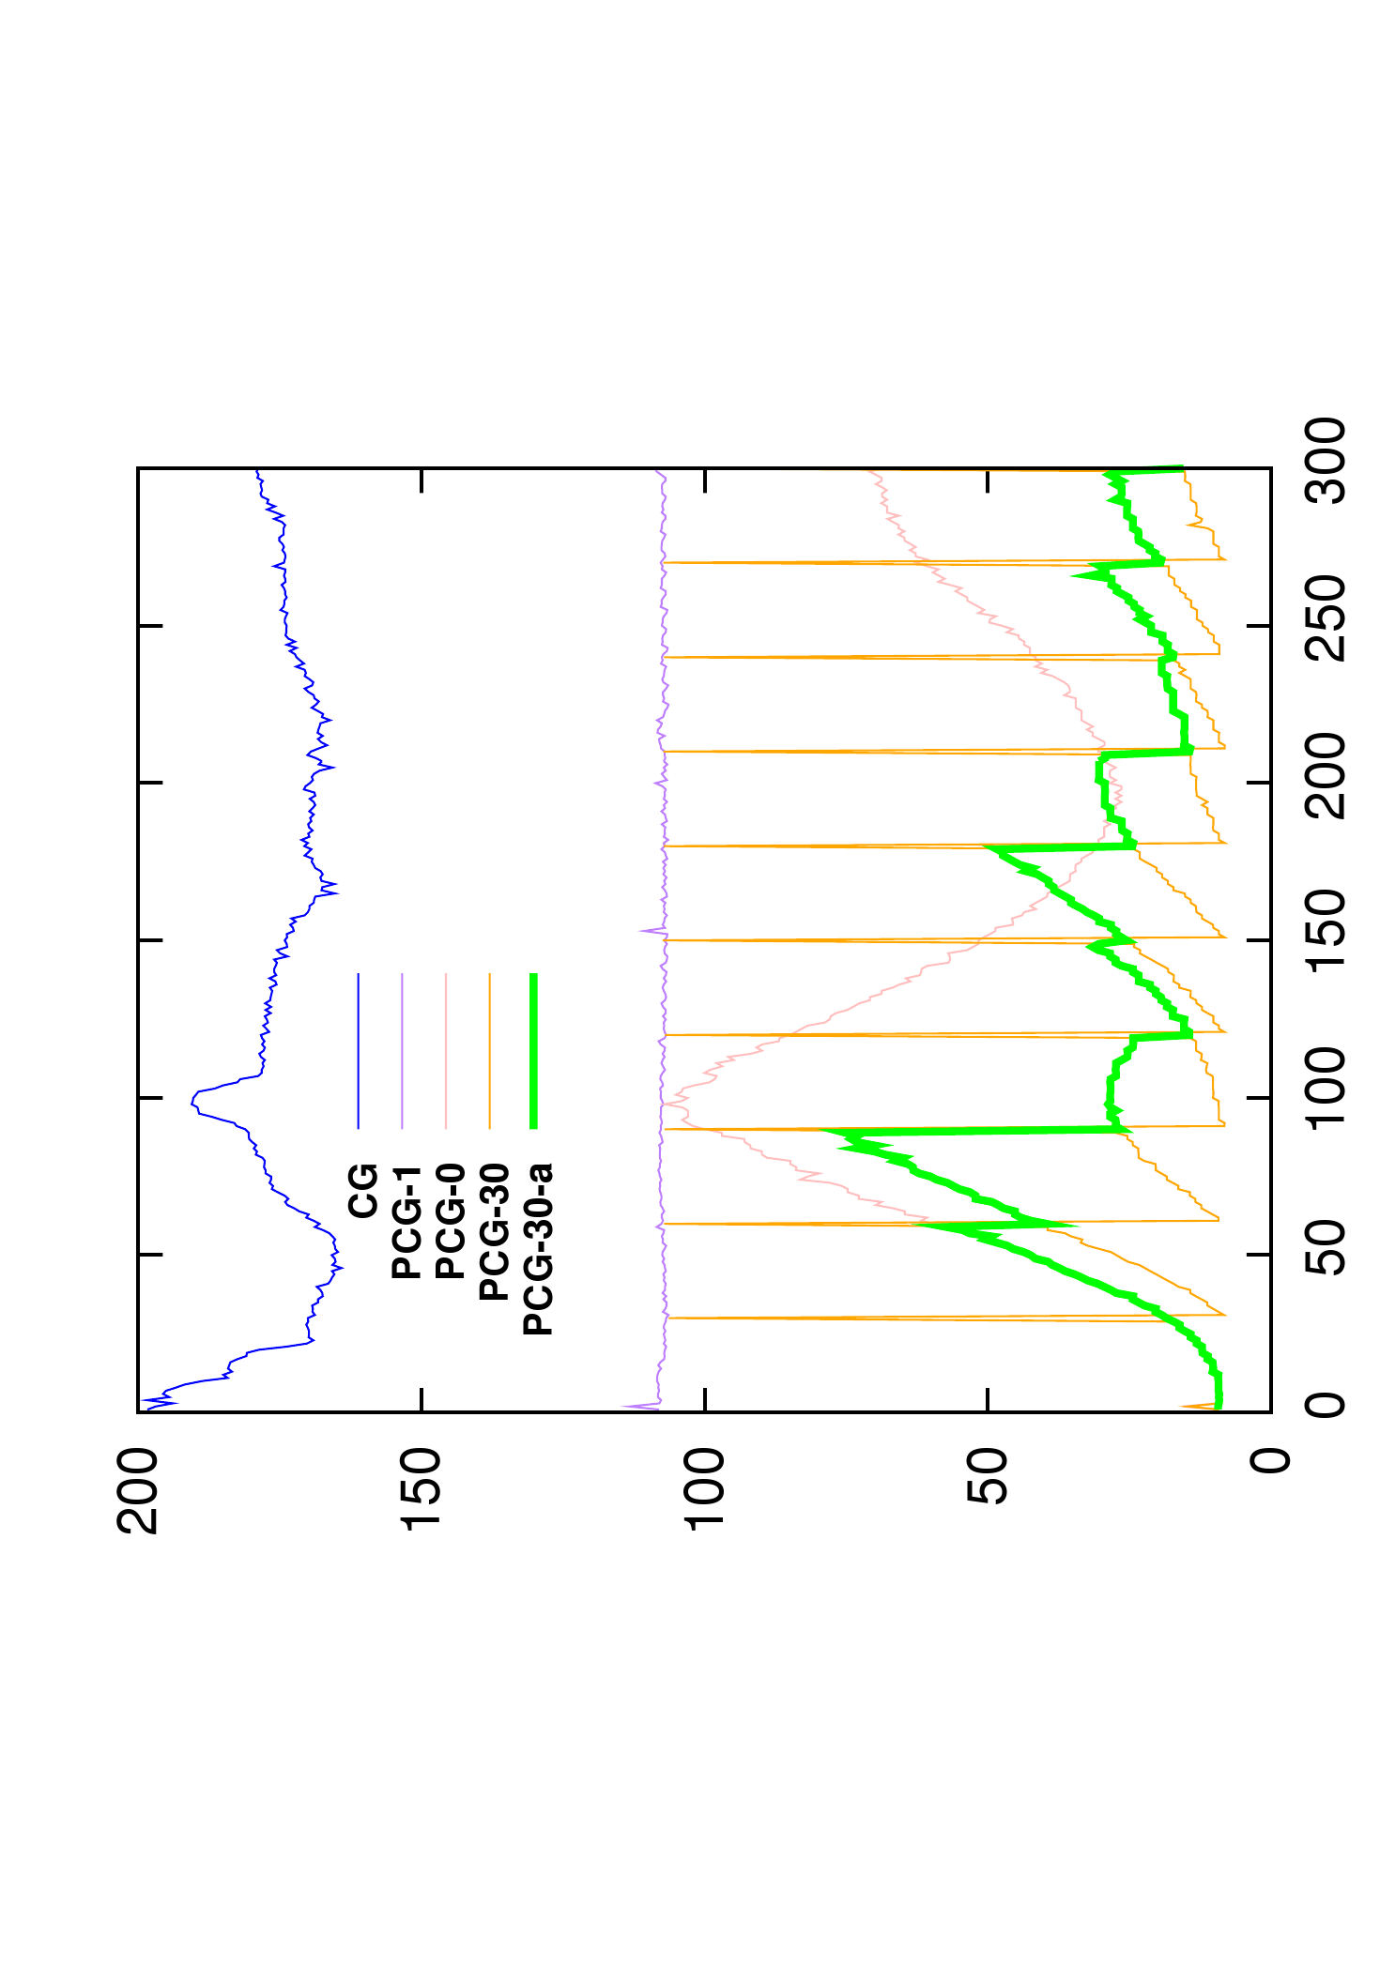
Asynchronous preconditioner
Number of iterations
Computation time (ms)

Slide 29
Asynchronous preconditioner
Heuristic to limit the divergence of the préconditionneur :
Apply rotation which appears since the last update of the preconditioner
Limit the effect of geometrical non linearities
We can compute rotations independently of the deformation model :
For co-rotational model we use directly the rotations computed by the model
For other models we use shape matching method [Müller et al. 2005]

Slide 30
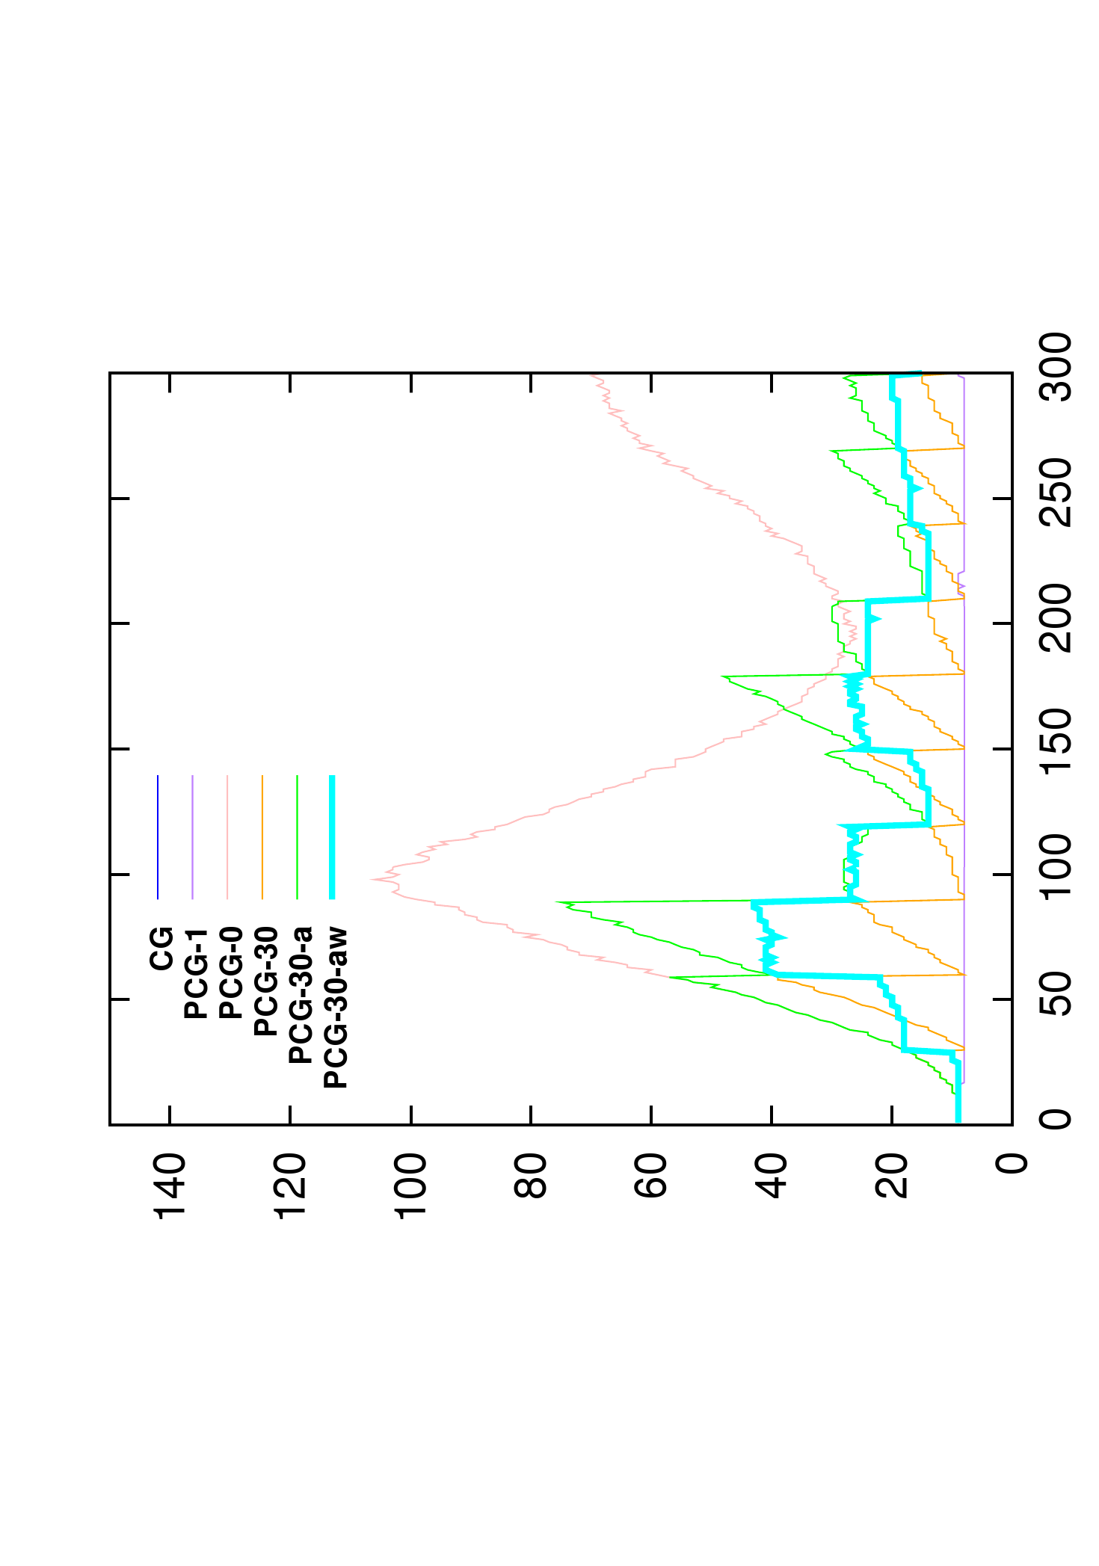
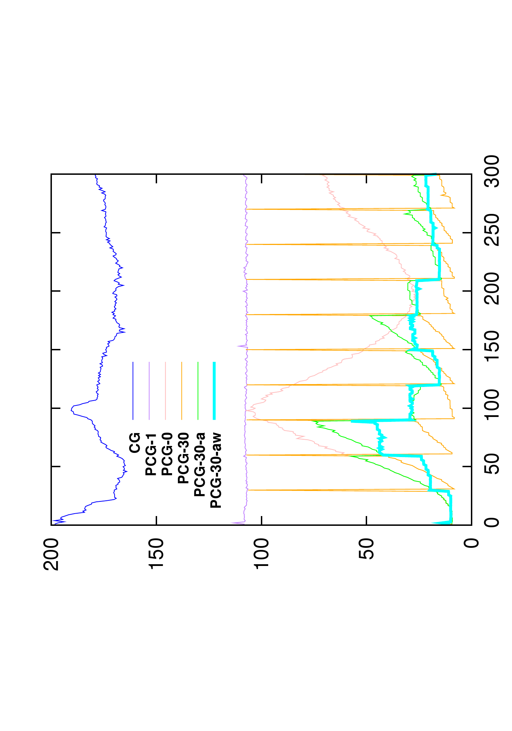
Asynchronous preconditioner
Number of iterations
Computation time (ms)

Slide 31
Asynchronous preconditioner
Heuristic to limit the divergence of the préconditionneur :
Apply rotation which appears since the last update of the preconditioner
Limit the effect of geometrical non linearities
We can compute rotations independently of the deformation model :
For co-rotational model we use directly the rotations computed by the model
For other models we use shape matching method [Müller et al. 2005]
Only few time steps of simulation are necessary to update the preconditioner.

Slide 32
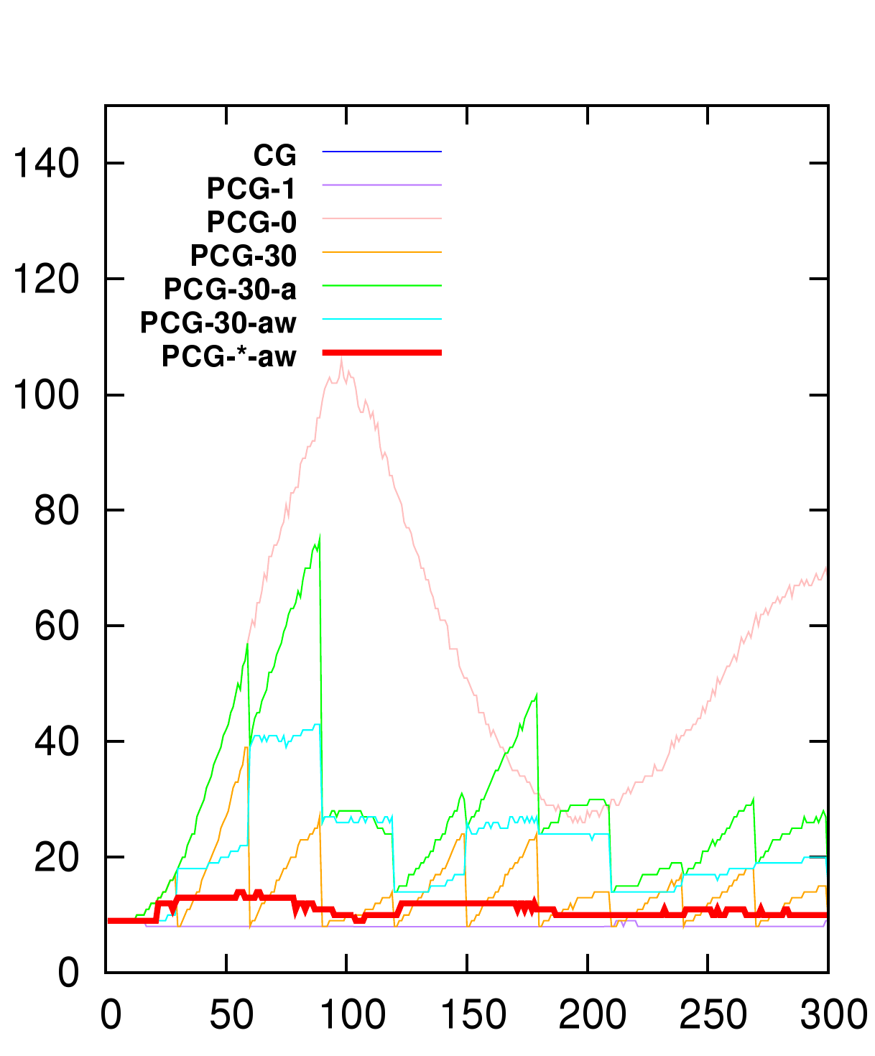
Asynchronous preconditioner
Number of iterations
Computation time (ms)

Slide 33
Deformation
Collision detection
1
Contacts resolution
Simulation rendering
2
3
4
Collision detection on GPU
Extension to volume constraints
5

Slide 34
Triangles rasterization
Extension of [Faure et al. 2008]
LDI Computation (Layer Depth Images)
2D Images discretized in pixel
Size of the pixels define the precision
Depth map of the objects
Sorted list of the intersections
LDI

Slide 35
Rastérisation volumique
3 LDI in orthogonal directions gives a 3D representation of the objects
OpenGL rendering
Collisions detection
Intersection volumes :
1 volume by pair of intersection
Gradients of the volume
Sum unitary gradients over each pixel

Slide 36
Triangles rasterization
Lmax
0
L1
1
Lmin
2
Project triangles
Projection des triangles
List cells by triangles
Liste les cellules par triangles
Sort
(cells,z)
Rasterization
Tri par (cellules,z)
Rastérisation
Initial mesh
Upper and lower line, Zmean, α, β,...
Triangles → Cells
Cells→ Triangles
LDI
LDI
LDI

Slide 37
Volume constraints
Transform Signorini in volume [Allard et al. 2010, Siggraph]
Associate a small area around one contact
Only one lagrangian multiplier on this area
We compute the necessary pressure to solve the contact
Friction support :
Compute an average frame around the contact to express friction

Slide 38
Parameter for accuracy
One constraint per intersection
Fast
Cannot simulate local variations
Separate volumes:
Groups of pixels
Take into account local variations
Independent from the topology
Compromise accuracy/computation time
Easy to control

Slide 39
Results
20 deformable Torus falling[Irving et al 2007]
GPU implicit integration
90k tetrahedra elements
97k collision triangles
12.4 FPS on a Nvidia Geforce GTX 580
Rasterization LDI: 5 ms
Contacts modelisation: 4 ms
FEM Solver: 71 ms

Slide 40
Avantages de la méthode
Enable real time computation
Large number of triangles
Choose accuracy :
Size of pixels, size of grid
Independent from the geometry
Keep a small number of constraints
Robust and accurate :
Handle large intersections at initial step
Handle friction
Handle self-collision without important overhead
Simulate data from patient-specific segmentation
Handle topological modifications:
No pre-computations
Limitations :
Only for volume objects
Can not anticipate collisions

Slide 41
Deformation
Collision detection
1
Contacts resolution
Simulation rendering
2
Gauss-Seidel parallelization
GPU computation of the compliance for beam model
GPU computation of the compliance based on the preconditioner
3
4
5

Slide 42
Computation of the compliance
Problem 3 : How to solve ${(\frac{1}{h²}M+\frac{1}{h}B+K)}^{−1}$ in real time?
$= {(\frac{1}{h²}M+\frac{1}{h}B+K)}^{−1} +$
avec $0≤ δ⊥λ≥0$
$$H H^{T}$$
$$δ δ_{0}$$
$$λ$$
$H$ is the jacobian of contacts (sparse)
$δ$ is a measure of the interpenetration
λ is the contact force
${(\frac{1}{h²}M+\frac{1}{h}B+K)}^{−1}$ is the compliance matrix
Consider only the diagonal
Compliance Warping [Saupin et al. 2008]
Pre-compute the inverse of the system
Warping to limit geometrical non linarites
Exploit the characteristics of the model:
[Courtecuisse et al. 2009, PBMB]
dt=0,01
dt=0,001
dt=0,0001
dt=0,01
Compliance
Warping
Not real time

Slide 43
Preconditioners for contacts
The Compliance matrix is only a scaled version of the inverse of the system
$$H {(\frac{1}{h²}M+\frac{1}{h}B+K)}^{−1}H^{T} h² H$$
$$≈ {\left(LDL\right)}^{−1}$$
$$= { A}^{−1}$$
$$H^{T}$$
Reuse the préconditionneur to solve contacts [Courtecuisse et al. 2011, MICCAI]
However, we don’t have ${ A}^{−1}$but it’s factorization
$$H^{T}$$
We know how to apply the preconditionneur :
$Solve$ $\left(LDL x=b\right) \overset{⇔}{ } x= {(LDL)}^{−1}b$
We repeat this operation until we get $S= {(LDL)}^{−1}H^{T}$
Finally we get the compliance matrix with:
LDL
$$S$$
$${H (LDL)}^{−1}H^{T}=H S$$
($H$ est creuse)
$$H$$
Compliance

Slide 44
GPU parallelization
The most time consumming task is the compuation of $S$
Each column can be computed in parallel
GPU
Multiprocessor
Multiprocessor
Multiprocessor
Multiprocessor
Multiprocessor
Multiprocessor
Thread
(0,0)
Thread
(0,1)
$$H^{T}$$
$$H^{T}$$
$$H^{T}$$
$$H^{T}$$
$$H^{T}$$
$$H^{T}$$
Thread
(1,0)
Thread
(1,1)
LDL
S
LDL
S
LDL
S
LDL
S
LDL
S
LDL
S
Thread
(2,0)
Thread
(2,0)
Each resolution is computed by a single multiprocessor
A second level of parallelism is used inside each resolution
Well suit to GPU architectures
Only use local synchronisations

Slide 45
Validation of the method
Compare the positions with different approximations of the Compliance
The green shape represent the exact solution
The object is non homogeneous : Red tetrahedra are stiffer than blue ones
With Asynchronous update of the preconditioner, we get almost the correct solution
The green part and the blue part overlap perfectly
dt=0,01
Compliance
Warping
dt=0,01
Update every 50 time steps
dt=0,01
Update every 20 time steps
dt=0,01
Update every 3 time steps on average

Slide 46
Computation time on GPU
With GPU implementation we can solve up to 128 constraints at the same cost
Real time computation is very limited on CPU (less than 10 constraints)
Enable to handle large number of contacts in real time on GPU
This method is well suit with LDI approach
Temps (sec)
Accélération
Nombre de Contraintes
Nombre de Contraintes

Slide 47
Advantages of the method
Enable to take into account the correct mechanical coupling between contacts
GPU implementation enable to achieve real time performances
Well suit to the collision detection by rasterization
Automatically handle topological changes:
Without an important overhead
Currently limited to carving (constant number of DOF)
Non stable dring the cutting.
Can be used with non linear models:
Preliminary test on hyperelasitc models (MJED)
Haptic with non linear models
Non stable when element are inverted

Slide 48
1
2
3
4
5

Slide 49
Résection hépatique
We use meshes from a CT segmentation
Reproduce patient specific simulations
Automatic 3D segmentation method [IRCAD]
We generate different models from the surface

Slide 51
Chirurgie de la cataracte
Cataract operation :
Opacification of the lens
Prevent the passage of the light
Treatment :
Surgical procedure to remove the disease lens
Lens opaque

Slide 53
Conclusion

Slide 54
Travaux futurs
Short term :
Use new preconditioners
Extension of LDI to a continuous collision detection
Make algorithms robust against topological modifications
Long term :
Validation of the deformation of the organs (error evaluation)
Creation automatic of medical simulations
Contributions at different level :
Algorithms parallelization
New algorithms based on GPU
Improve precision of simulation in real time
Produce realistic medical simulations
Toward using the simulation during the surgery

Slide 55
Thank you for your attention

